Slide 1

Fundamentals of Software Architecture Part 1 - A book by Neal Ford and Mark Richards
From developer to architect

Slide 2

CONTENTS
Introduction
Expectations of an Architect
Architectural Thinking and Planning
Architecture characteristics

Slide 3
01
02
Clarity on Software Architecture and Architect Role
Deep Dive into Software Architecture
Setting Expectations
03
04
Real-world Examples & Case Studies
Developing Architect Career Path

Slide 4

The Big Picture
Notes:
أهرامات الجيزة هي من أقدم وأعظم الإنجازات الهندسية في التاريخ. رغم بساطة شكلها الخارجي، إلا أنها تخفي تعقيدات هندسية مذهلة في داخلها
1. من الخارج، يبدو الهرم بسيطًا، لكن داخله يحتوي على ممرات وغرف معقدة:
الهرم الأكبر (خوفو) يحتوي على ثلاث غرف رئيسية: الغرفة السفلية المحفورة في الصخر، وغرفة الملكة في وسط الهرم، وغرفة الملك في الأعلى. هذه الغرف متصلة بممرات معقدة، بما في ذلك الممر الصاعد الكبير. كما يوجد نظام تهوية معقد يمتد من غرفة الملك إلى الخارج.
2. بُني الهرم طبقة فوق طبقة:
تم بناء الأهرامات باستخدام طريقة "الطبقات المائلة". بدأ البناء بقاعدة مستوية، ثم تم وضع الطبقات المائلة من الحجر الجيري فوق بعضها البعض. و مازال سر ازاي البناؤون بأدوات بسيطة رفعوا الأحجار الضخمة.
3. صمدت الأهرامات لآلاف السنين:
بُنيت الأهرامات لتدوم إلى الأبد، وقد نجحت في الصمود لأكثر من 4500 عام. استخدم المصريون القدماء تقنيات بناء متقدمة، مثل استخدام الحجر الجيري عالي الجودة للكساء الخارجي، وتقنيات التعشيق الدقيقة بين الكتل الحجرية، مما منح الأهرامات قوة هيكلية استثنائية.
4. الدقة الهندسية: تم بناء الأهرامات بدقة رياضية مذهلة:
الهرم الأكبر مربع تقريبًا عند قاعدته، مع فرق لا يتجاوز 58 ملم بين أطول وأقصر جانب.
5. تم توجيه الأهرامات بدقة نحو النجوم:
الجوانب الأربعة للهرم الأكبر موجهة بدقة نحو الاتجاهات الأصلية (الشمال، الجنوب، الشرق، الغرب) بانحراف لا يتجاوز 0.15 درجة. كما أن الممر الشمالي للهرم كان موجهًا نحو النجم القطبي في ذلك الوقت (النجم ألفا دراكونيس).
6. تحتوي الأهرامات على أنظمة أمنية معقدة لحماية محتوياتها:
تضمنت الأهرامات عدة أنظمة أمنية، مثل الممرات الضيقة والمنحدرة، والأبواب الحجرية الثقيلة، وغرف الخداع. في هرم خوفو، هناك ثلاث ألواح جرانيتية ضخمة تسد المدخل إلى غرفة الملك، وآلية معقدة لإغلاق الممرات بعد الدفن.

Slide 5

Notes:
This is the scope or context we will be talking about , SDLC
We know that the main goal of the what we do as developers is achieving system for domain or business goal and its requirements.
We should go through some sdlc to achieve that and ofcourse there are some different roles and phases
Explain the common stages like in agaile or waterfall
Now we talking specifically in design phase but what before it also considered as part of the architect role..

Slide 6

Design phase nature in Agile vs Waterfall

Slide 7
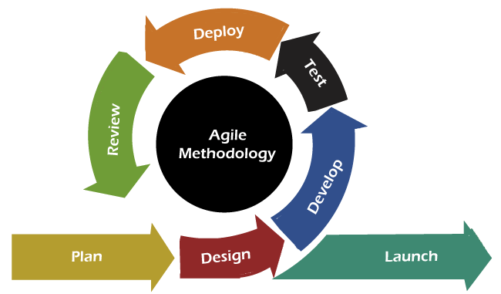
Design phase nature
Design phase nature
Agile is Iterative
Notes:
We know that agile is iterative

Slide 8
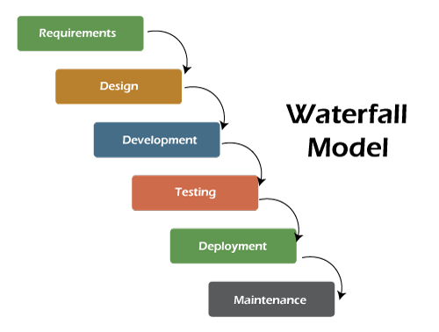
Design phase nature
Design phase nature
Waterfall is long-lasting

Slide 9
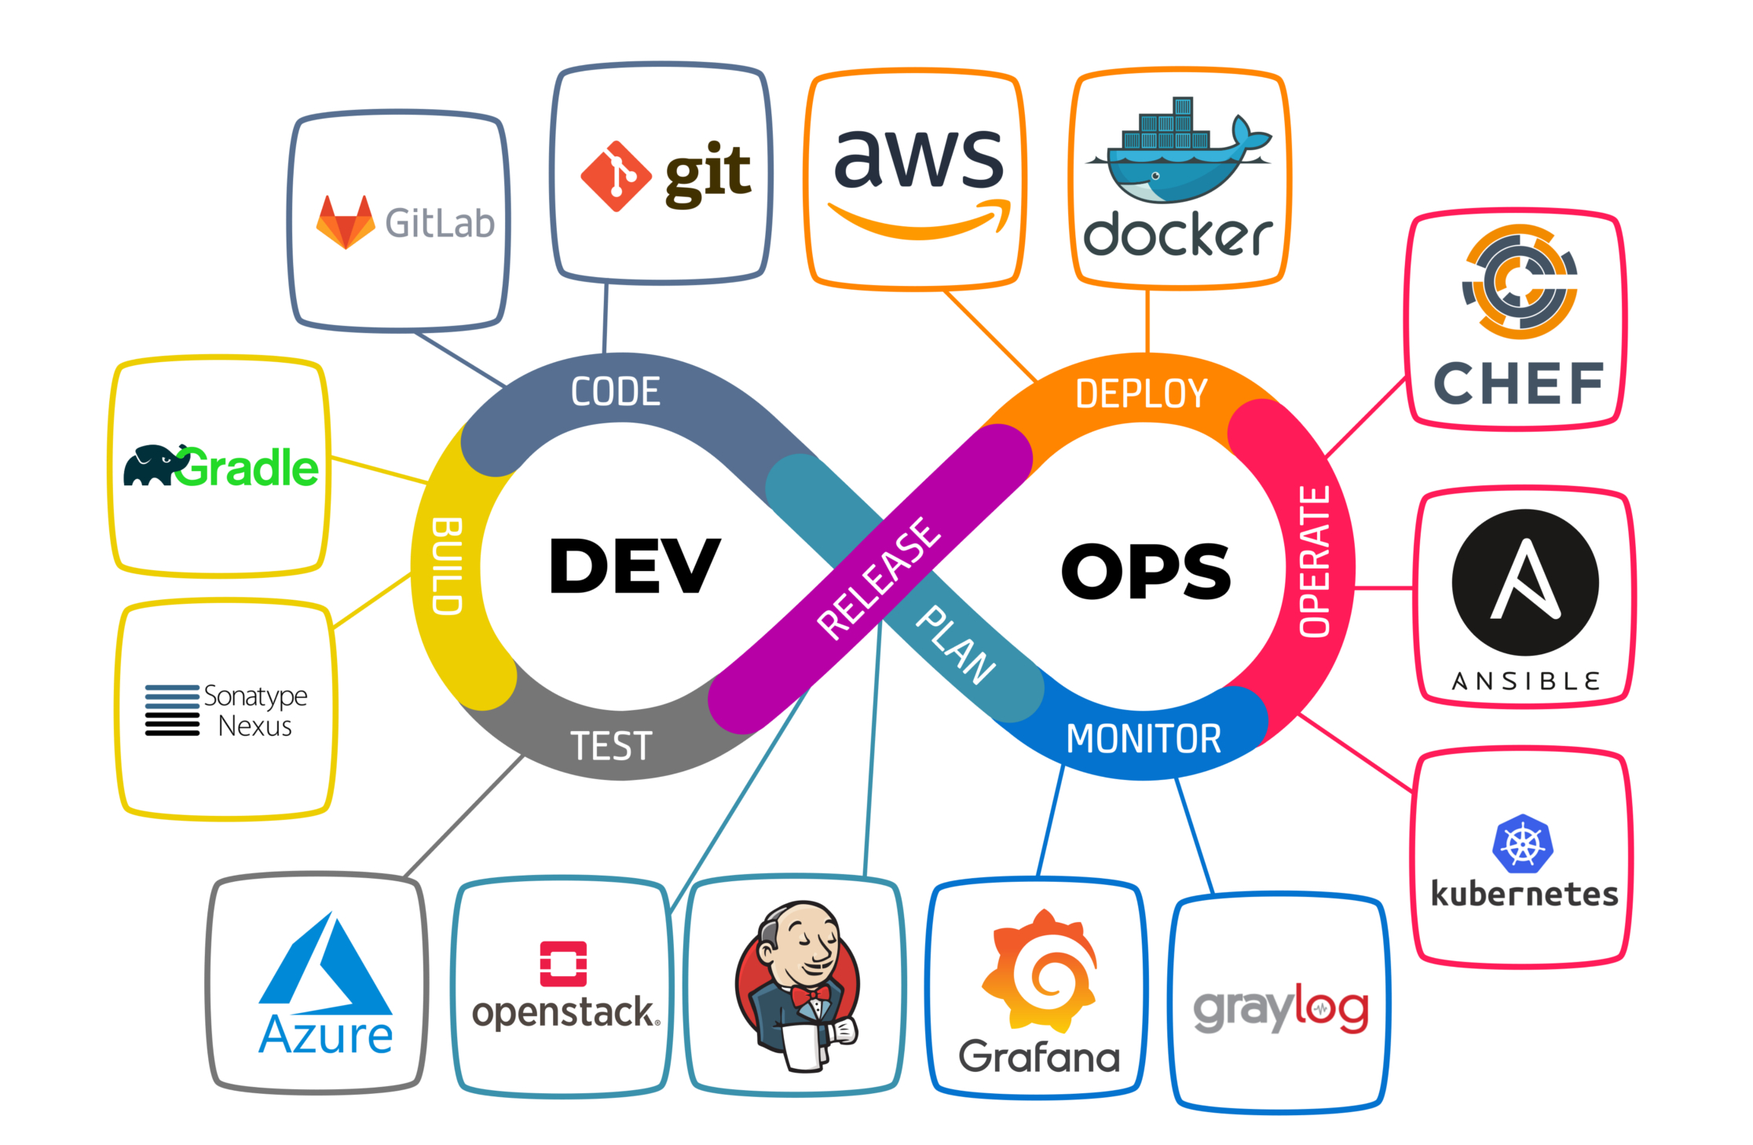
The revolution of DevOps and CI/CD.
Notes:
Software architecture has significant relevance to DevOps and CI/CD. The design of software architecture can greatly influence the ease and effectiveness of implementing continuous integration (CI) and continuous deployment (CD) practices. A well-designed architecture that supports modularity, scalability, and flexibility can facilitate smoother and more efficient CI/CD processes by enabling faster integration of changes, more reliable automated testing, and more straightforward deployment strategies.

Slide 10
The struggle to define Software architecture
Notes:
The industry as a whole has struggled to precisely define “software architecture.” Some architects refer to software architecture as the blueprint of the system, while others define it as the roadmap for developing a system.
The following figure illustrates a way to think about software architecture. In this definition, software architecture consists of the structure of the system, combined with architecture characteristics (“-ilities”) the system must support, architecture decisions, and finally design principles.

Slide 11
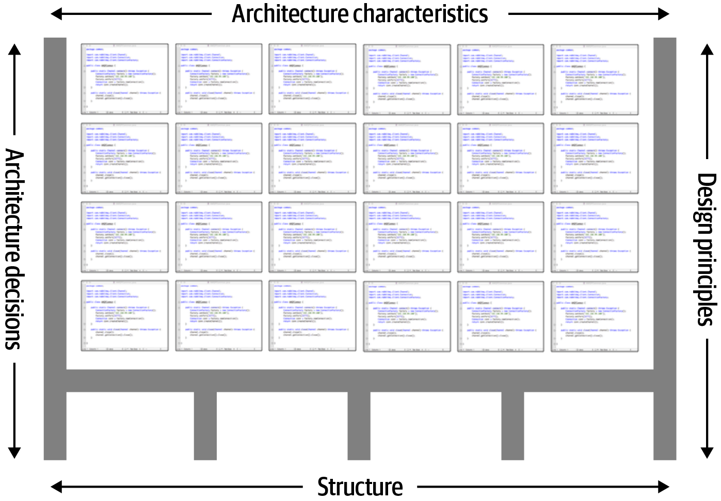
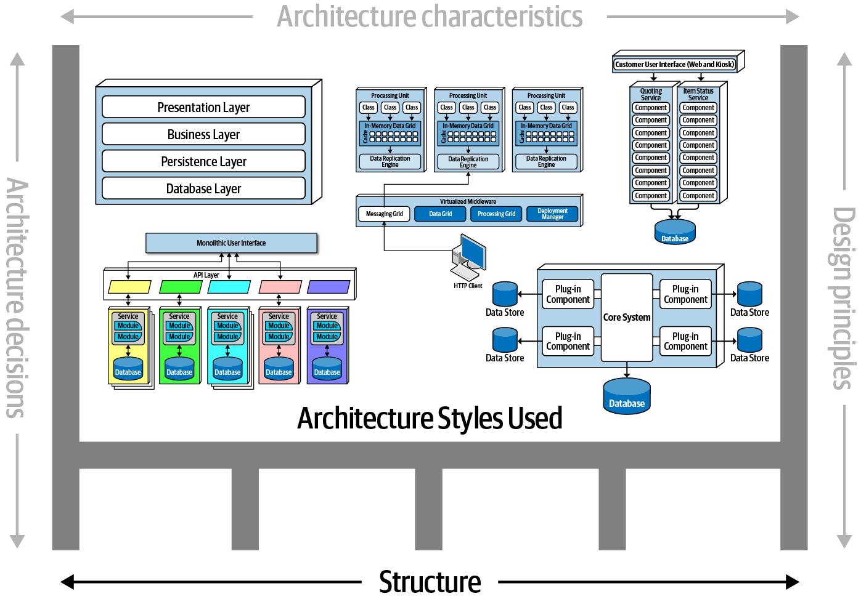
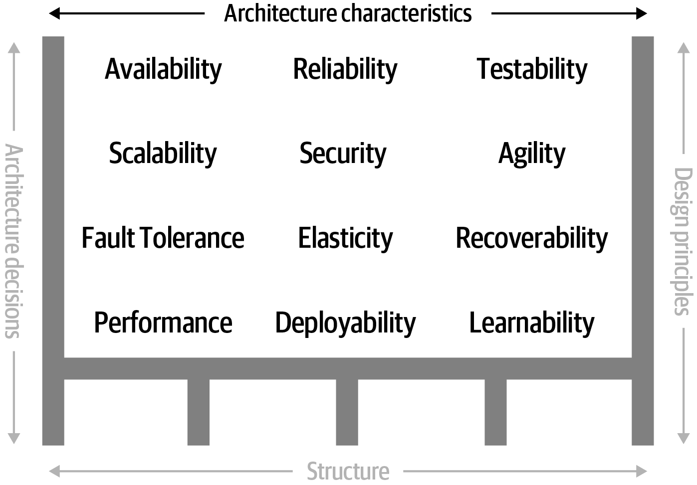
Notes:
The structure of the system refers to the type of architecture styles the system is implemented in (such as microservices, layered, or microkernel). For example, suppose an architect is asked to describe an architecture, and that architect responds “it’s a microservices architecture.” Here, the architect is only talking about the structure of the system, but not the architecture of the system. Knowledge of the architecture characteristics, architecture decisions, and design principles is also needed to fully understand the architecture of the system.
Architecture characteristics are another dimension of defining software architecture. The architecture characteristics define the success criteria of a system as they are required in order for the system to function properly.
The next factor that defines software architecture is architecture decisions. Architecture decisions define the rules and constraints for how a system should be constructed and direct the development teams on what is and what isn’t allowed. For example, an architect might make an architecture decision that only the business and services layers within a layered architecture can access the database, restricting the presentation layer from making direct database calls.
design principles. A design principle differs from an architecture decision in that a design principle is a guideline. For example, a design principle states that the development teams should leverage asynchronous messaging between services within a microservices architecture to increase performance. An architecture decision (rule) could never cover every condition and option for communication between services, so a design principle can be used to provide guidance for the preferred method (in this case, asynchronous messaging).

Slide 12

Much like art, must be understood within its context.
So, keep in mind that all architectures are a product of their context.
Notes:
When studying architecture, readers must keep in mind that, like much art, it can only be understood in context. Many of the decisions architects made were based on realities of the environment they found themselves in.
For example, Imagine strolling into a 2002 data center and telling the head of operations “Hey, I have a great idea for a revolutionary style of architecture, where each service runs on its own isolated machinery, with its own dedicated database (microservices). So, that means I’ll need 50 licenses for Windows, another 30 application server licenses, and at least 50 database server licenses.” In 2002, trying to build an architecture like microservices would be inconceivably expensive.

Slide 13

Why Good Software Architecture Matters??
Notes:
Whatever you design it is an architecture, but how far is it good ?
Architecture represents the fundamental design decisions that shape a system.
These decisions are difficult and costly to change later, making early architectural choices critical for the system’s success.

Slide 14
Everything changes including norms
Notes:
Software architects must make decisions within this constantly changing ecosystem. Because everything changes, including foundations upon which we make decisions, architects should reexamine some core axioms and norms that were informed earlier.
For example, earlier books about software architecture don’t consider the impact of DevOps because it didn’t exist when these books were written.

Slide 15
Why Good Software Architecture Matters?
Managing Change
A well-designed architecture facilitates change.
Notes:
Changes to a software system are inevitable.
Adaptability as is crucial in dynamic business environments where requirements evolve.
Such as using Key architectural principles that facilitate change:
Modularity: Breaking the system into independent, interchangeable modules.
Abstraction: Hiding complex implementation details behind simple interfaces.
Uber's Architecture Transformation
Uber provides an excellent case study of how a well-designed architecture facilitates managing change and adapting to rapid growth:
Initial Architecture: Uber started with a monolithic architecture in 2009. This worked well for their initial launch in San Francisco.
Rapid Growth Challenges: As Uber expanded to more cities and countries, the monolithic architecture became a bottleneck. It was difficult to scale, deploy changes, and add new features rapidly.
Transition to Microservices: Around 2015, Uber they had to began transitioning to a microservices architecture. This allowed them to: a) Scale different components independently: For example, the dispatch system could be scaled separately from the payment system. b) Deploy changes faster:
Results of this adaptable architecture:
Uber grew from a small startup to a global company operating in over 10,000 cities across 72 countries.
They handle millions of trips per day, processing vast amounts of real-time data. They've expanded .
They can rapidly deploy new features and experiments in specific markets.
This example illustrates how Uber's well-designed, adaptable architecture allowed them to manage significant changes in scale, functionality, and business model.

Slide 16
Why Good Software Architecture Matters?
Simply to meet requirements successfully
Notes:
Good Architecture ensures that the technical aspects of the system align with business objectives.
Ensuring the system delivers value to stakeholders.
how architecture affects meeting requirements:
Alignment with Business Needs:
Bad Architecture Example: A healthcare provider builds a monolithic system for patient records. As regulations change requiring more granular access controls and data segregation, the tightly coupled nature of the system makes it nearly impossible to implement these changes without risking the entire system's stability, failing to meet evolving compliance requirements.
Flexibility to Adapt:
Good Architecture Example: A social media platform uses a modular, plugin-based architecture for their content feed algorithm. When they need to add a new feature like personalized ad insertion, they can simply develop a new module and plug it into the existing system with minimal disruption to other features.

Slide 17
Why Good Software Architecture Matters?
Easing communication among stakeholders and understanding the system.
Notes:
A well-defined architecture serves as a blueprint for all stakeholders, including developers, project managers, and business analysts.
Providing a common language and architecture artifacts allows them to understand the software system.
Communication is essential key for successful management of any project…

Slide 18
Why Good Software Architecture Matters?
Guides Development
Notes:
Good architecture provides a clear framework and set of guidelines and best practices for the development team.
Reduces the complexity and prevent making incorrect decisions.
Architecture docs serves as training for team members.
Such as log of architecture decisions..

Slide 19
Why Good Software Architecture Matters?
Balancing
functional
and
non-functional
requirements
Notes:
Functional requirements define what the system should do (features, capabilities).
Non-functional requirements (or architecture characteristics) define how the system should perform (scalability, security, performance, etc.).
So Non-functional is essential part of the architecture (defined as architecture characteristics).
Non-functional requirements are often overlooked in initial planning but can be critical to a system's success. For example, a system might have all the right features but fail if it can't handle the required user load or doesn't meet security standards.
The key here is that a good architecture must balance both types, not just focus on functional aspects.
Non-functional requirements often have a more significant impact on the overall system architecture than functional requirements.
For instance, a high availability requirement might necessitate a distributed system architecture.

Slide 20
Why Good Software Architecture Matters?
Giving you the ability to predict software system qualities
Notes:
By defining a clear and well-thought-out architecture, you can anticipate how the system will behave under various conditions.
This predictive capability allows for better planning, risk mitigation.
Let's consider an e-commerce platform like Amazon.
Their ability to predict system qualities through architecture has been crucial to their success:
Scalability prediction: Amazon's architects designed a microservices architecture that allows them to predict how the system will scale during peak shopping periods like Black Friday.
Performance prediction: The architecture includes caching layers and content delivery networks (CDNs). This design allows Amazon to predict and ensure fast page load times even as user numbers grow globally.
Reliability prediction: Amazon's use of distributed systems and redundancy in their architecture allows them to predict and maintain high availability.

Slide 21
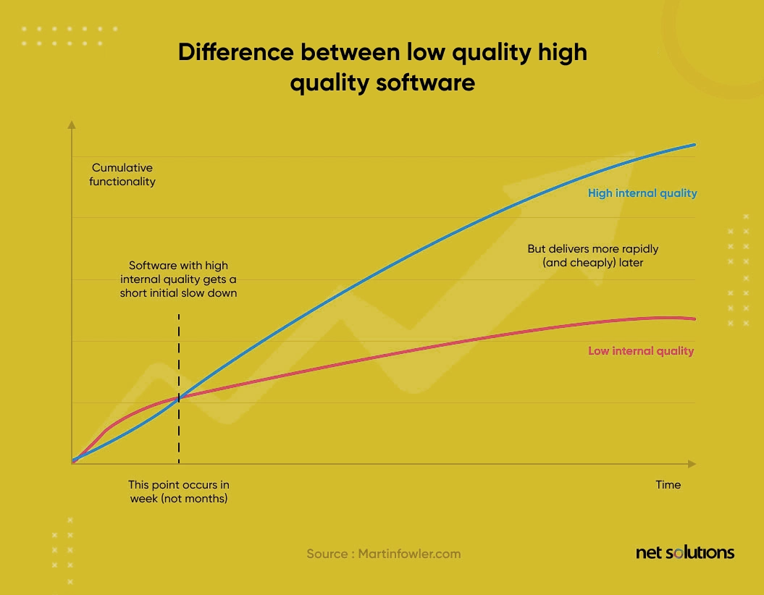
Ensure the longevity of the software’s internal quality.
Notes:
Suppose you have two similar products that you launched within a three month gap.
There are two scenarios:
You launched Product A in Jan 2021. It supports a messy source code because the development team wanted to launch and monopolize the market as early as possible.
You launched Product B in March 2021. It has a well-structured and organized software architecture. The development team worked on the design and architectural decisions early in the process, prioritizing quality over a faster launch.
Which Product will be more successful: A or B?
Product A might monopolize the market initially and convert better. However, product adoption will eventually subside because the messy code will lead to technical debt pileups. These pile ups will, in turn, make it challenging to introduce new updates and bug fixes on the fly.
On the other hand, Product B might have a market entry gap, but it will be easier to maintain a faster shipping cadence. The customer needs will be looked after without breaking the shipping cadence, thus making for a larger win.
That is why the architecture in software engineering matters.
It ensures you release high-quality software while maintaining a faster shipping cadence.

Slide 22

Why is there no clear path for software architects?

Slide 23
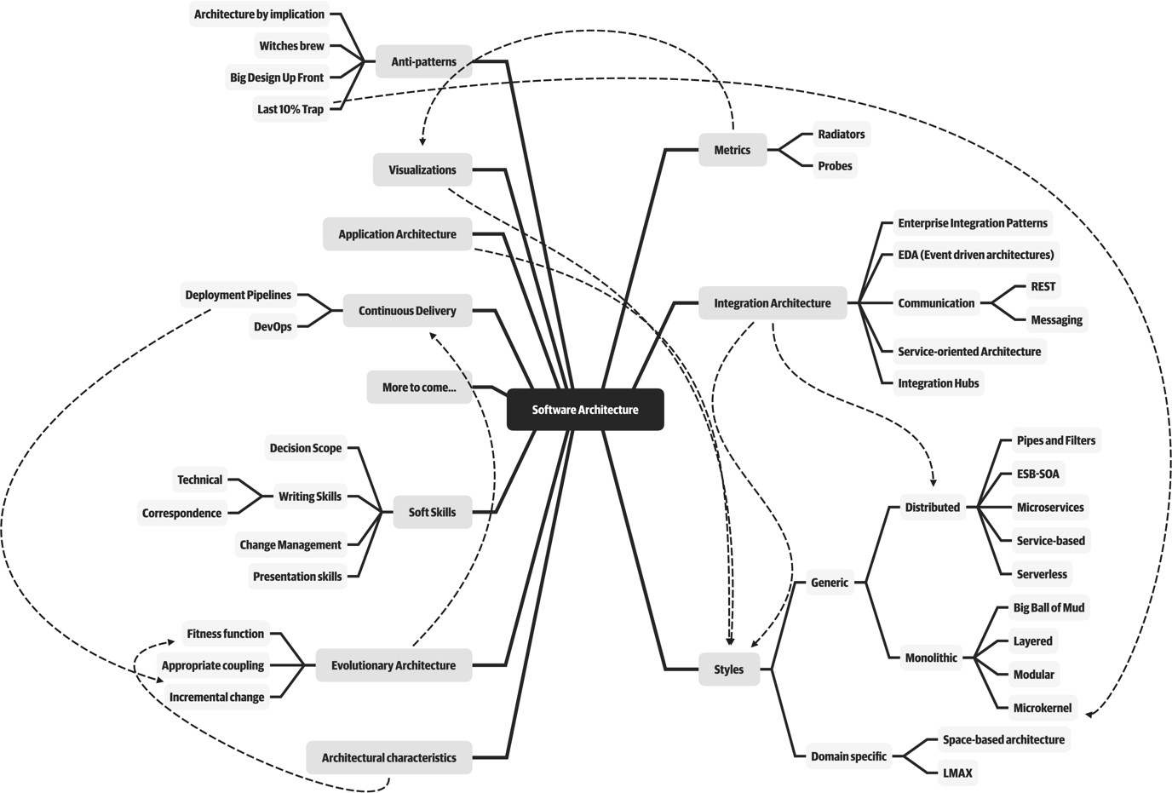
Expanded Role
Notes:
The job “software architect” appears near the top of numerous lists of best jobs across the world.
So why do software architects have no clear path?
First, the industry doesn’t have a good definition of software architecture itself.
Second, the following figure illustrates in the mindmap, the role of software architect embodies a massive amount and scope of responsibility that continues to expand. A decade ago, software architects dealt only with the purely technical aspects of architecture, like modularity, components, and patterns. Since then, because of new architectural styles (like microservices), the role of software architect has expanded.
But in the end it is a role and not necessarily to be a job , just need some one to fill in this architect role wether a senior developer or principal such as role of the team leader,

Slide 24
Software architecture is a constantly moving target
Notes:
Third, software architecture is a constantly moving target because of the rapidly evolving software development ecosystem.
Any definition cast today will be hopelessly outdated in a few years.
The Wikipedia definition of software architecture provides a reasonable overview, but many statements are outdated, such as “Software architecture is about making fundamental structural choices which are costly to change once implemented.”
as within microservices architecture, the idea of incremental built in—it is no longer expensive to make structural changes in microservices.

Slide 25

Expectations of an Architect
Seven core expectations
Notes:
Defining the role of a software architect presents as much difficulty as defining software architecture. It can range from expert programmer up to defining the strategic technical direction for the company.
So it’s recommended focusing on the expectations of an architect.

Slide 26
Make architecture decisions
Expectations of an Architect
Guide rather than specify
Notes:
Finding the correct line of decisions

Slide 27
Ensure compliance with decisions
Expectations of an Architect
Development teams are following architecture decisions and design principles defined.

Slide 28
Continually analyze the architecture
Expectations of an Architect
Seeking and suggest Improvements
NO Agility for code modifications

Slide 29
Diverse exposure and experience
Expectations of an Architect
Most environments these days are heterogeneous
Stretch the comfort zone
Keep Current with Latest Trends

Slide 30
Have business domain knowledge
Expectations of an Architect
To be effective software architect

Slide 31
Possess interpersonal skills
Expectations of an Architect
Exceptional interpersonal skills is a difficult expectation for most developers and architects
It’s always a people problem

Slide 32
Understand and navigate politics
Expectations of an Architect
Every decision an architect makes will be challenged

Slide 33

Architectural Thinking and Planning

Slide 34

Architectural Eye
Four main aspects
of thinking
like an architect

Slide 35
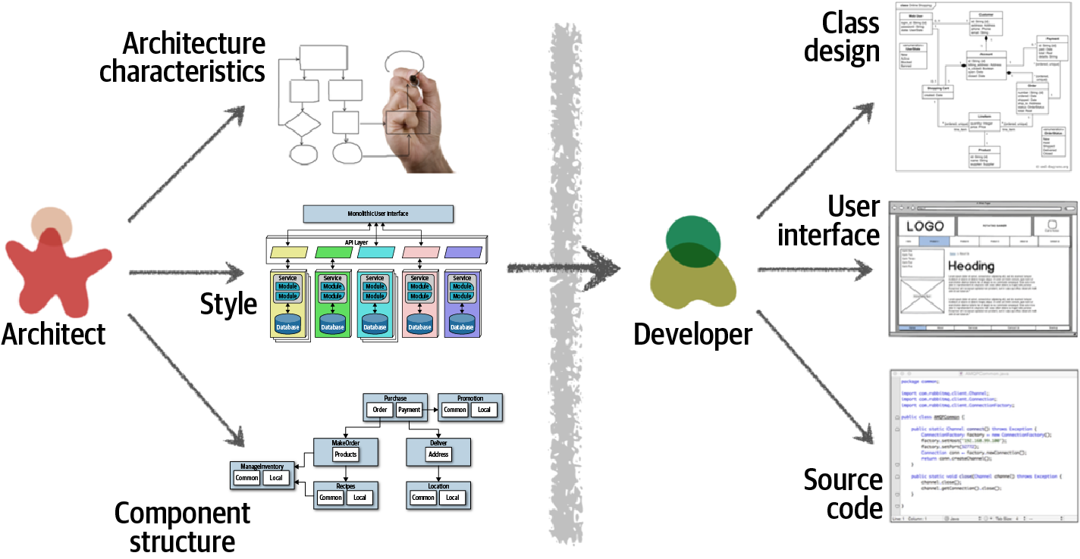
Architecture VS Design

Slide 36
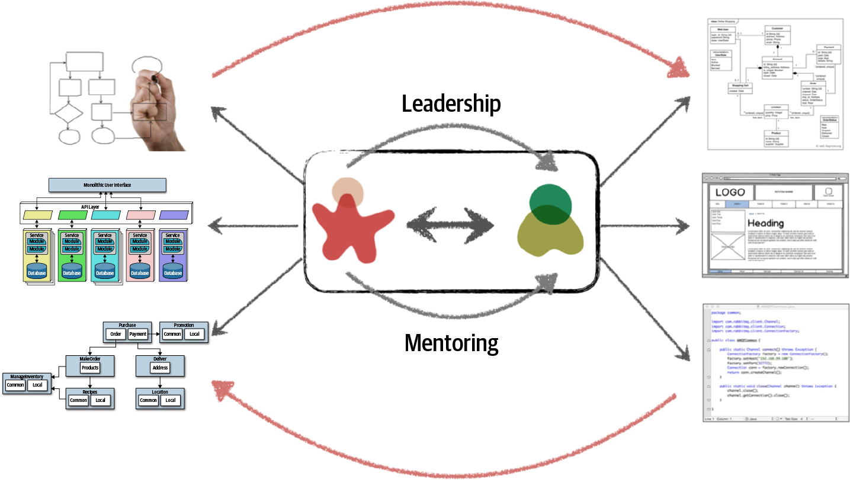
Architecture VS Design

Slide 37
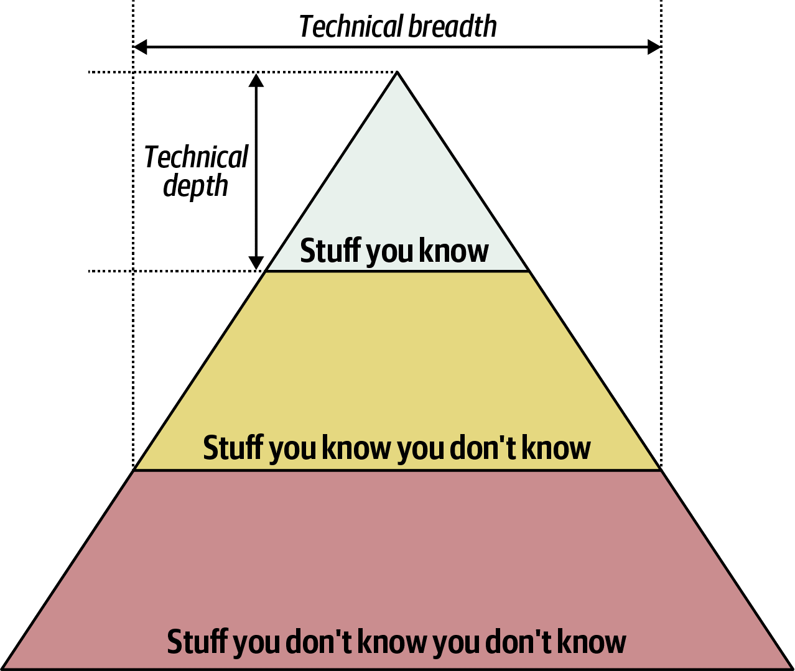
Technical Breadth and Technical Depth

Slide 38

Analyzing Trade-Offs
Architecture is the stuff you can’t Google.

Slide 39

Everything in architecture is a trade-off

Slide 40
Understanding Business Drivers
Translating those requirements into architecture characteristics

Slide 41

Balancing Architecture and Hands-On Coding

Slide 42
Balancing Architecture and Hands-On Coding
Bottleneck Trap
The only person capable of making changes or decisions regarding certain core parts of the codebase,
creates a single point of failure..

Slide 43
Balancing Architecture and Hands-On Coding
Bottleneck Trap
It can lead to frustration among team members
who are dependent on the architect's contributions to advance their work.

Slide 44
Bottleneck Trap
One way to avoid the bottleneck trap
First, delegate to dev team
then focus on coding a piece of business functionality

Slide 45
Bottleneck Trap
Three positive things happens
Gaining hands-on experience
Giving dev team ownership of the harder code parts (where it belongs).
Most important, Architect is writing the same business-related source code as the dev team.

Slide 46
Balancing Architecture and Hands-On Coding
Remain Hands-on & Technical Depth
without having to
practice coding from home

Slide 47
Remain Hands-on & Technical Depth
Doing frequent proof-of-concepts or POCs
Or doing frequent code reviews

Slide 48
Remain Hands-on & Technical Depth
Architect can tackle some of the technical debt..
While freeing the dev team up to work on the critical functional user stories.

Slide 49

Architectural Principles

Slide 50


Slide 51
Separation of Concerns SOC
One of the Most Fundamental Principle

Slide 52
2 out of 5 SOLID principles Based on SOC
Modularity
Single Responsibility
Interface Segregation
Notes:
Modularity : A higher level structural approach to implementing the Separation of Concerns (SoC) principle

Slide 53

Modularity
Notes:
Modularity : A higher level structural approach to implementing the Separation of Concerns (SoC) principle

Slide 54
95% of the words said about the benefits of “modularity” and that little is said about how to achieve it.

Slide 55
Modularity
How to measure Modularity?
High
Cohesion
is good

Slide 56

Modularity
Cohesion Measures
Functional cohesion Sequential cohesion Communicational cohesion Procedural cohesion Temporal cohesion Logical cohesion Coincidental cohesion

Slide 57


Modularity
For example,
Customer Maintenance:
add customer,
update customer,
get customer,
notify customer,
get customer orders,
cancel customer orders.
Customer Maintenance:
add customer, update customer, get customer, notify customer
Order Maintenance:
get customer orders, cancel customer orders

Slide 58
IT Depends..

Slide 59
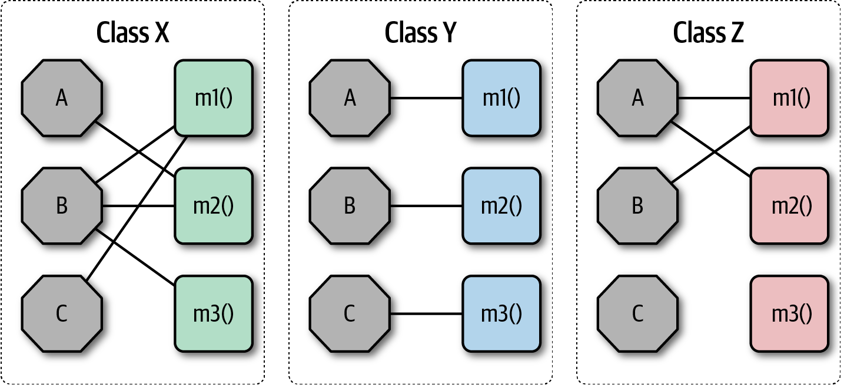
Modularity
Which is better in cohesion?

Slide 60
Modularity
Coupling
Loose
is good
Boost the flexibility, maintainability and scalability by “decoupling” your code !

Slide 61
Modularity
Decoupling Strategies Examples
Interface-based Design
Dependency Injection
Publish-Subscribe Patterns
Event-Driven Architectures
Microservices Architecture
...
..

Slide 62
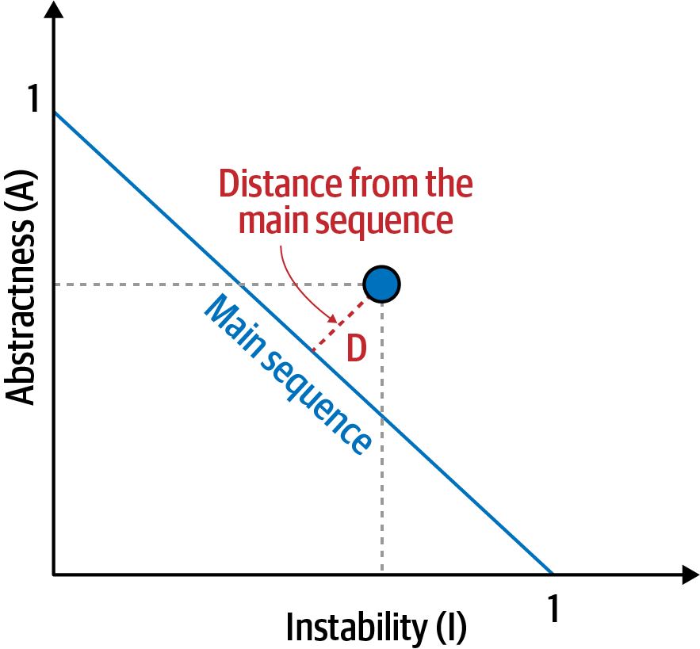
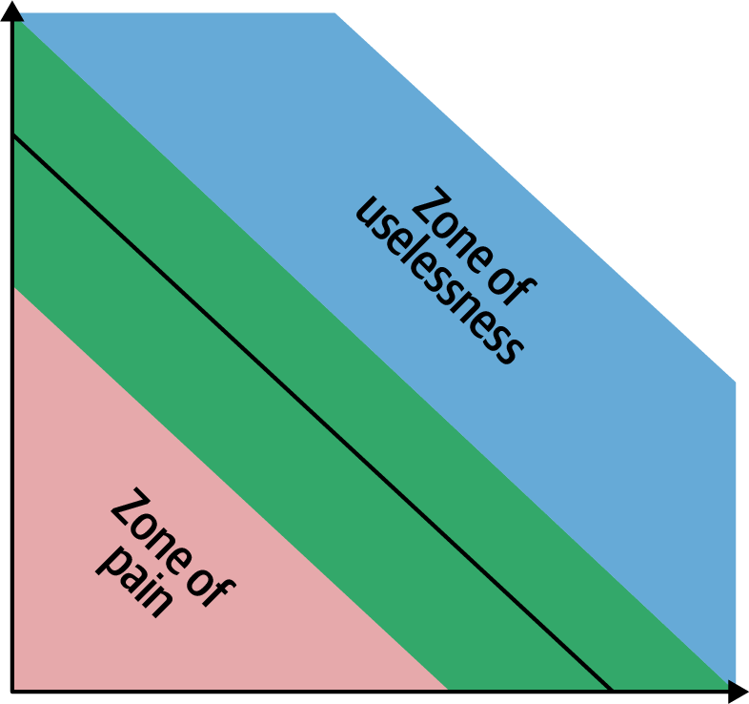
Modularity
Balanced approach

Slide 63

Architecture characteristics
Notes:
Key to success of the overall system

Slide 64
One key responsibility of a software architect
Defining,
discovering,
and analyzing
architectural characteristics
Notes:
Architects may collaborate on defining the domain or business requirements, but as a must, one key responsibility entails defining, discovering, and analyzing architectural characteristics as it isn’t directly related to the domain functionality.

Slide 65

Notes:
What is the diff between elasticity and scalability

Slide 66
An architecture characteristic meets three criteria
Specifies a nondomain design consideration
Notes:
architecture characteristics specify operational and design criteria for success, Concerning how to implement the requirements and why certain choices were made.
For example, a common important architecture characteristic specifies a certain level of performance for the application, which often doesn’t appear in a requirements document.
no requirements document states “prevent technical debt,” but it is a common design consideration for architects and developers.

Slide 67
An architecture characteristic meets three criteria
Influences some structural aspect of the design
Notes:
The primary reason to describe the characteristics is : does this architecture characteristic require special structural consideration and modifications to succeed? If Yes then it is a crucial one to address.
For example, security. However, it rises to the level of architectural characteristic when the architect needs to design something special for the requirements. Meaning require special structural modifications to ensure the success criteria of the design.
Consider these two cases surrounding payment:
Third-party payment processor If an integration point handles payment, then the architecture shouldn’t require special structural considerations. The design has standard security hygiene, such as encryption and hashing.
In-application payment processing If the application must handle payment processing, the architect may design a specific module, component, or service to isolate the critical security concerns structurally. Now, the architecture characteristic has an impact on both architecture and design. (meaning it will be affecting/impacting the other structural aspect of the design).

Slide 68
An architecture characteristic meets three criteria
Only the ones are critical or important to application success
Make trade-offs.
Notes:
Support for each architecture characteristic adds complexity to the design and structure .
a bigger problem is that some characteristics can conflict with others.
For example, if an architect wants to improve security, it will almost certainly negatively impact performance: the application must do more on-the-fly encryption, indirection for secrets hiding, and other activities that potentially degrade performance.
a critical job for architects lies in making trade-offs between several competing concerns, choosing the fewest critical architecture characteristics

Slide 69
Characteristics Categorized

Slide 70
Identifying Characteristics
Operational
Availability
Performance
Structural
Maintainability
Portability
Cross-Cutting
Authentication
Authorization
Scalability
Elasticity
…
Extensibility
Configurability
…
Security
Accessibility
…
Notes:
Many of the definitions overlap and no complete list of standards exists. For example, consider availability and reliability, which seem to overlap in almost all cases.
architects and Employees can use ubiquitous language to solve this lack of standard definition and create their own.
Availability
How long the system will need to be available (if 24/7, steps need to be in place to allow the system to be up and running quickly in case of any failure).
Performance
Includes stress testing, peak analysis, analysis of the frequency of functions used, capacity required, and response times. Performance acceptance sometimes requires an exercise of its own, taking months to complete.
Maintainability
How easy is it to apply changes and enhance the system?
Portability
Does the system need to run on more than one platform? (For example, does the frontend need to run against Oracle as well as SAP DB?
Configurability
Ability for the end users to easily change aspects of the software’s configuration (through usable interfaces).
Extensibility
How important it is to plug new pieces of functionality in.
Accessibility
Access to all your users, including those with disabilities like colorblindness or hearing loss.
Authentication
Security requirements to ensure users are who they say they are.
Authorization
Security requirements to ensure users can access only certain functions within the application (by use case, subsystem, webpage, business rule, field level, etc.).
Security
Does the data need to be encrypted in the database? Encrypted for network communication between internal systems? What type of authentication needs to be in place for remote user access?

Slide 71
Identifying Architectural Characteristics
Notes:
An architect uncovers architecture characteristics in at least three ways

Slide 72
Identifying Characteristics
Extracting architecture characteristics from domain concerns
Notes:
An architect must be able to translate domain concerns to identify the right architectural characteristics.
implicitly come from inherent domain knowledge by architects, one of the many reasons that domain knowledge is always beneficial for architects.
collaborating with domain stakeholders to define the characteristics and to keep the final list as short as possible.(select the top three most important characteristics)
One problem is that architects and domain stakeholders speak different languages. (Architects talk about scalability, interoperability, fault tolerance, etc. Domain stakeholders talk about mergers and acquisitions, user satisfaction, time to market, and competitive advantage.
there is usually a translation from domain concerns to architecture characteristics.

Slide 73
Identifying Characteristics
Translation of domain concerns to architecture characteristics
Domain concern | Architecture characteristics
Mergers and acquisitions | Interoperability, scalability, adaptability, extensibility
Time to market | Agility, testability, deployability
User satisfaction | Performance, availability, fault tolerance, testability, deployability, agility, security
Competitive advantage | Agility, testability, deployability, scalability, availability, fault tolerance
Time and budget | Simplicity, feasibility
Notes:
An architect must be able to translate domain concerns to identify the right architectural characteristics.
collaborating with domain stakeholders to define the characteristics and to keep the final list as short as possible.(select the top three most important characteristics)
One problem is that architects and domain stakeholders speak different languages. (Architects talk about scalability, interoperability, fault tolerance, etc. Domain stakeholders talk about mergers and acquisitions, user satisfaction, time to market, and competitive advantage.
there is usually a translation from domain concerns to architecture characteristics.

Slide 74
Identifying Characteristics
A trap, focusing on only one of the ingredients
Notes:
“Due to regulatory requirements, it is absolutely imperative that we complete end-of-day fund pricing on time.”
An ineffective architect might just focus on performance as it seems to be the primary focus of that domain concern. However, that architect will fail for many reasons. First, it doesn’t matter how fast the system is if it isn’t available when needed. Second, as the domain grows the system must be able to also scale to finish end-of-day processing in time. Third, the system must also be reliable so that it doesn’t crash as end-of-day fund prices are being calculated. Fourth, what if the system crashes in the middle of processing? It must be able to recover and restart where the pricing left off. Finally, are the fund prices being calculated correctly? So, in addition to performance, the architect must also equally place a focus on availability, scalability, reliability, recoverability, and auditability.

Slide 75
Identifying Characteristics
Extracting Architecture Characteristics from Requirements
Notes:
adopt a curious approach, actively seeking more detailed requirements and clarifying assumptions
For example, suppose an architect designs an application that handles class registration for university students. assume that the school has 1,000 students and 10 hours for registration. Should an architect design a system assuming consistent scale, making the implicit assumption that the students during the registration process will distribute themselves evenly over time? Or, based on knowledge of university students' habits and proclivities, should the architect design a system that can handle all 1,000 students attempting to register in the last 10 minutes? Rarely will details like this appear in requirements documents.

Slide 76
Identifying Characteristics
Architecture katas
nealford.com/katas
Notes:
architecture katas, a clever method to allow architects a way to practice deriving architecture characteristics from domain-targeted descriptions.

Slide 77
Identifying Characteristics
Case Study: Silicon Sandwiches (Architecture Kata)
Description:
A national sandwich shop wants to enable online ordering (in addition to its current call-in service).
Users:
Thousands, perhaps one day millions
Requirements:
Users will place their order, then be given a time to pick up their sandwich and directions to the shop (which must integrate with several external mapping services that include traffic information)
If the shop offers a delivery service, dispatch the driver with the sandwich to the user
Mobile-device accessibility
Offer national daily promotions/specials
Offer local daily promotions/specials
Accept payment online, in person, or upon delivery
Additional context
Sandwich shops are franchised, each with a different owner
Parent company has near-future plans to expand overseas
Corporate goal is to hire inexpensive labor to maximize profit
Notes:
First, separate the candidate architecture characteristics into explicit and implicit characteristics.
One of the first details that should catch an architect’s eye is the number of users: currently thousands, perhaps one day millions (this is a very ambitious sandwich shop!)
Thus, scalability—handle a large number of users—is one of the top architecture characteristics. Notice that the problem statement didn’t explicitly ask for scalability,
However, we also probably need elasticity.
The requirement for elasticity did not appear in requirements, yet the good architect should identify this as an important consideration.

Slide 78
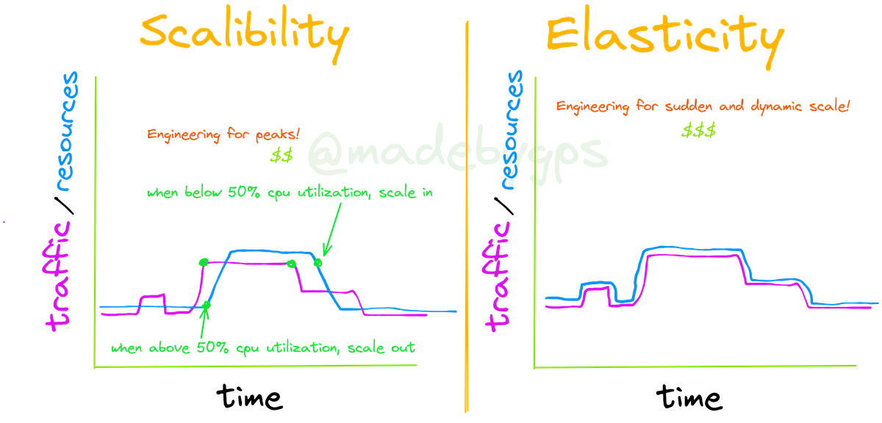
time
time
Notes:
Scalability
Ability for the system to perform and operate as the number of users or requests increases. It has two types : Vertical or Horizontal Scaling.
Elasticity
Ability for the system to automatically or dynamically scale resources up or down as needed, in response to changing unexpected demand. It is a more dynamic concept than scalability.
Some systems are scalable but not elastic.
For example, consider a hotel reservation system. Normal days vs special sales days.
Elasticity adds a layer of intelligence and automation to scalability.
Elasticity is crucial in cloud computing, where the pay-as-you-go pricing model makes elasticity economically attractive.

Slide 79
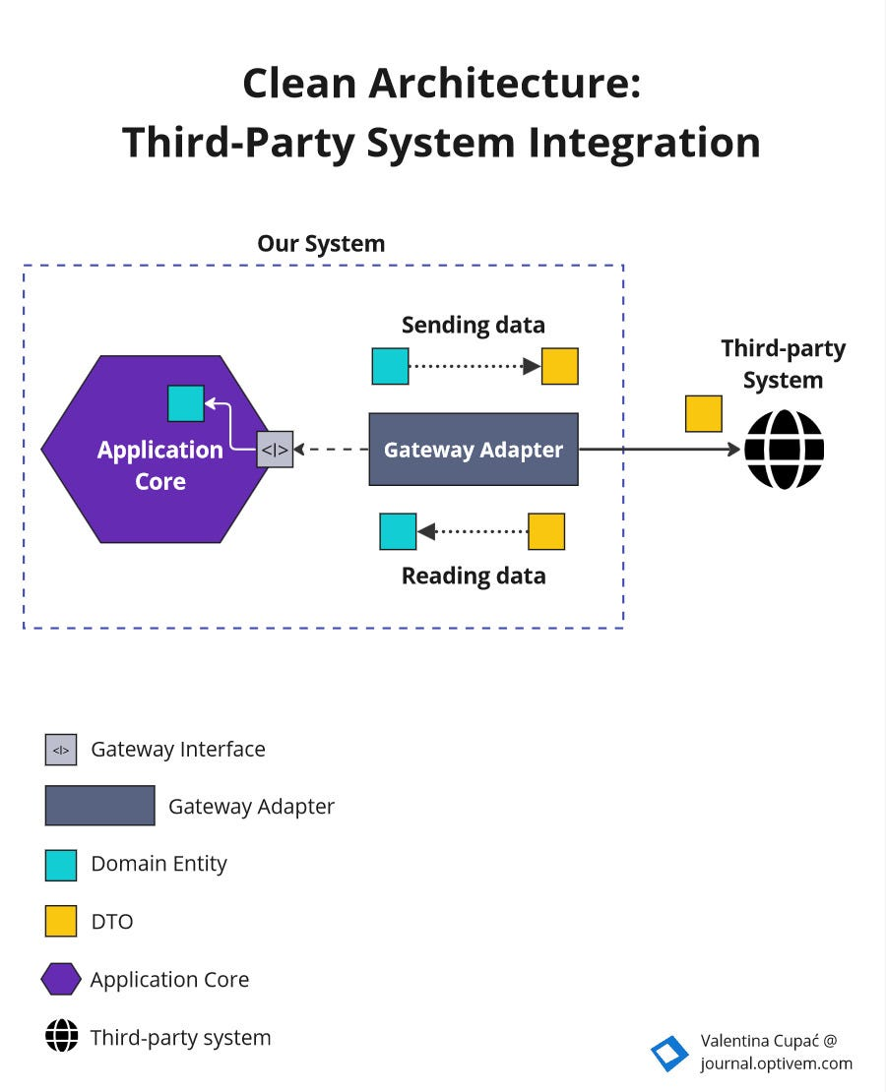
Case Study: Silicon Sandwiches
Explicit Characteristics
Requirements:
Users will place their order, then be given a time to pick up their sandwich and directions to the shop (which must integrate with several external mapping services that include traffic information)
Impact the reliability
Notes:
External mapping services imply integration points, which may impact aspects such as reliability. For example, if a developer builds a system that relies on a third-party system, yet calling it fails.
Be wary of over-specifying architecture characteristics.

Slide 80
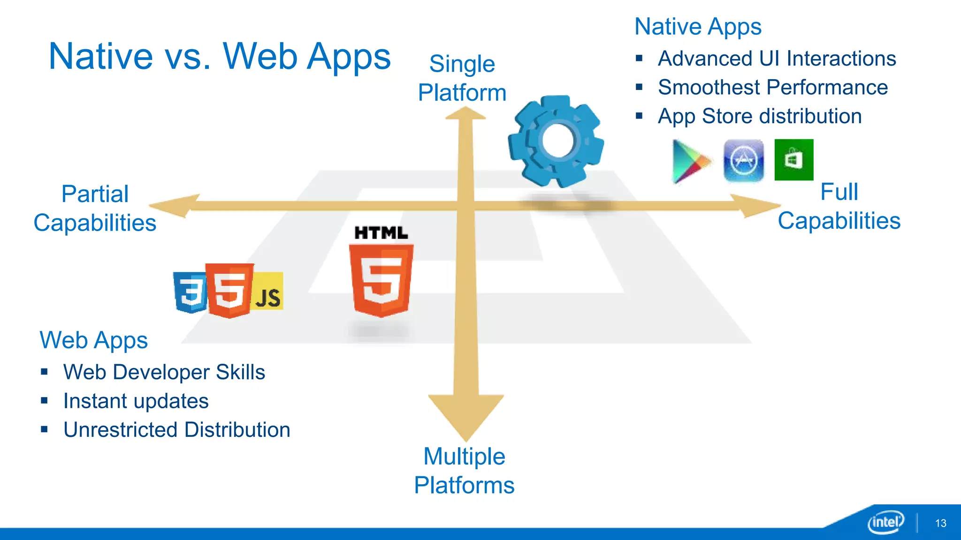
Case Study: Silicon Sandwiches
Explicit Characteristics
Requirements:
Mobile-device accessibility.
Primarily affect the design of the application
Notes:
This requirement will primarily affect the design of the application, pointing toward building either a portable web application or several native web applications.
Given the budget constraints and simplicity of the application, the design points toward a (portable or progressive web) mobile-optimized web application.
Thus, the architect may define some specific performance architecture characteristics for page load time and other mobile-sensitive characteristics.
Notice the architect should collaborate with user experience designers, domain stakeholders, and other interested parties to vet decisions like this.

Slide 81
Case Study: Silicon Sandwiches
Explicit Characteristics
Requirements:
Offer national daily promotions/specials.
Offer local daily promotions/specials
Both of these requirements specify customizability
Notes:
Both of these requirements specify customizability. Notice that requirement one also implies customized traffic information based on address.
the architect may consider customizability as an architecture characteristic.
For example, an architecture style such as microkernel architecture supports customized behavior extremely well by defining a plug-in architecture. In this case, the default behavior appears in the core, and developers write the optional customized parts, based on location, via plug-ins.
However, a traditional design can also accommodate this requirement via design patterns (such as Template Method).
This is common in architecture and requires architects to constantly weigh trade-offs between competing options.

Slide 82
Case Study: Silicon Sandwiches
Explicit Characteristics
Requirements:
Accept payment online, in person, or upon delivery.
Online payments imply security, but nothing in this requirement suggests a special heightened level of security.

Slide 83
Case Study: Silicon Sandwiches
Explicit Characteristics
Requirements:
Sandwich shops are franchised, each with a different owner.
This requirement may impose cost restrictions on the architecture—the architect should check the feasibility regarding each owner.
Notes:
Since each franchise is owned by a different individual or entity, the financial resources available for technology investments can vary widely. Some owners may have limited budgets, which means the architecture must be cost-effective to implement and maintain.

Slide 84
Case Study: Silicon Sandwiches
Explicit Characteristics
Requirements:
The parent company has near-future plans to expand overseas.
This requirement implies internationalization, or i18n.
But shouldn’t require special structure to accommodate.
Notes:
Many ui ux design techniques exist to handle this requirement, which shouldn’t require special structure to accommodate.
Resource Bundling : Store all user-facing text, images, and cultural formats (dates, currencies) in external resource files (e.g., properties files, JSON, XML)

Slide 85
Case Study: Silicon Sandwiches
Explicit Characteristics
Requirements:
The corporate goal is to hire inexpensive labor to maximize profit.
This implies Usability, but again is more concerned with design than architecture characteristics.
Notes:
This requirement suggests that usability will be important, but again is more concerned with design than architecture characteristics (No need to consider it).

Slide 86
Case Study: Silicon Sandwiches
Implicit Characteristics
Performance
No one wants to buy from a sandwich shop that has poor performance, especially at peak times.
Notes:
The third architectural characteristic we derive from the preceding requirements is performance: no one wants to buy from a sandwich shop that has poor performance, especially at peak times. However, performance is a nuanced concept—what kind of performance should the architect design for?

Slide 87
Case Study: Silicon Sandwiches
Implicit Characteristics
Availability & Reliability
Availability: making sure users can access the sandwich site. Closely related to Reliability
—again, no one wants to purchase from a site that continues dropping connections.
Notes:
Many architecture characteristics aren’t specified in requirements documents, yet they make up an important aspect of the design.
Availability: making sure users can access the sandwich site. Closely related to availability is reliability: making sure the site stays up during interactions—no one wants to purchase from a site that continues dropping connections.

Slide 88
Case Study: Silicon Sandwiches
Implicit Characteristics
Security
No one wants to create insecure software.
Notes:
Security appears as an implicit characteristic in every system
However, it may be prioritized depending on criticality.
An architect might assume that payments should be handled by a third party. Thus, as long as developers follow the good design and general security hygiene (not passing credit card numbers as plain text, not storing too much information, and so on), the architect shouldn’t need any special structural design to accommodate security.

Slide 89
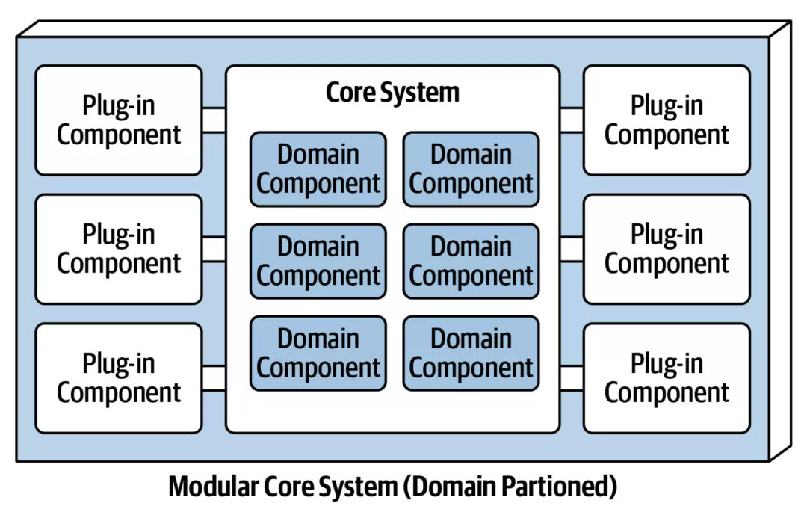
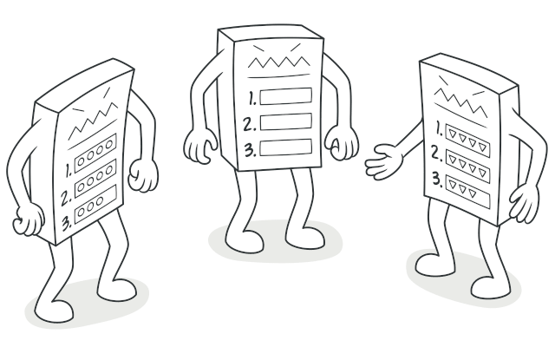
DESIGN VERSUS ARCHITECTURE TRADE-OFFS
Regarding Customizability characteristic
Notes:
problem domain offer custom behavior: recipes, local sales, and directions that may be locally overridden.
This design element isn’t critical to the success of the application though.
but the question then becomes: architecture or design? Note design resides within the architecture
The architect could choose microkernel.
competing concerns, developers could implement the customization using the Template Method design pattern.
Which design is better? it depends
are there good reasons, such as performance and coupling, not to implement a microkernel architecture?
Second, are other architecture characteristics more difficult in one design versus the other?
Third, the cost to support all the architecture characteristics in each design versus pattern?
This type of architectural trade-off analysis makes up an important part of an architect’s role.

Slide 90

Measuring Characteristics

Slide 91
Operational Measures
THE MANY FLAVORS OF PERFORMANCE
Request-response cycles
First-page render times to a target (500 ms)
K-weight budgets for page downloads
Notes:
Performance exhibits remarkable depth and variety, extending beyond general metrics like request-response cycles. Architects and DevOps engineers have developed detailed performance budgets to address specific application areas, such as optimizing first-page render times to a target of 500 ms to enhance user engagement. Furthermore, progressive organizations have introduced K-weight budgets for page downloads, setting limits on the bytes' worth of libraries and frameworks to accommodate physical network constraints, particularly for mobile devices in areas with high latency. This nuanced approach to performance, tailored to the unique demands of modern web and mobile applications, illustrates the intricate measures organizations adopt to refine user experience and operational efficiency.

Slide 92
Structural Measures
CC = E - N + 2
CYCLOMATIC
COMPLEXITY
public void decision(int c1, int c2) {
if (c1 < 100) // point of decision
return 0;// possible decision
else if (c1 + C2 > 500)// point of decision
return 1;// possible decision
else
return -1;// possible decision
}
//The cyclomatic complexity for Example is 3 (=3 – 2 + 2)
Notes:
What about measuring internal structural characteristics, such as well-defined modularity? Some metrics and common tools do allow architects to address some critical aspects of code structure,
An obvious measurable aspect of code is complexity, defined by the cyclomatic complexity metric.
(CC) is a code-level metric designed to provide an objective measure for the complexity of code, at the function/method, class, or application level, developed by Thomas McCabe, Sr., in 1976.
It is computed by applying graph theory to code, specifically code decision points, which cause different execution paths. For example, if a function has no decision statements (such as if statements), then CC = 1. If the function had a single conditional, then CC = 2 because two possible execution paths exist.
The formula CC = E - N + 2, where N represents nodes (points of decision), and E represents edges (possible decisions). Consider the C-like code.

Slide 93
Structural Measures
CYCLOMATIC
COMPLEXITY
WHAT’S A GOOD VALUE FOR CYCLOMATIC COMPLEXITY?
It depends!
But in general, under 10 is acceptable.
Notes:
It depends on the complexity of the problem domain.
are functions complex because of the problem domain or because of poor coding?
In general, the industry thresholds for CC suggest that a value under 10 is acceptable, barring other considerations such as complex domains.
Engineering practices like test-driven development have the accidental (but positive) side effect of generating smaller, less complex methods on average for a given problem domain. When practicing TDD, developers try to write a simple test, then write the smallest amount of code to pass the test. This focus on discrete behavior and good test boundaries encourages well-factored, highly cohesive methods that exhibit low CC.

Slide 94
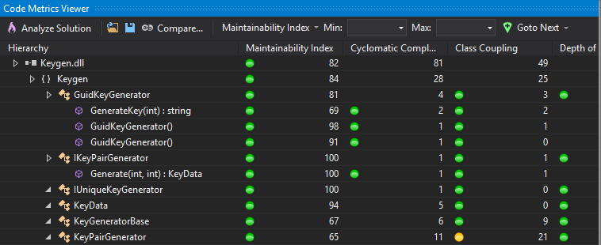
Structural Measures
Tools for Code Analysis
https://learn.microsoft.com/en-us/visualstudio/code-quality/code-metrics-values?view=vs-2022
Notes:
Various tools for code analysis exist that can help architects and developers evaluate different aspects of code quality. Tools like those available in Visual Studio provide insights into code maintainability, cyclomatic complexity, potential bugs, and adherence to coding standards. These tools, while limited and not offering a comprehensive measure of internal code quality, enable the identification and mitigation of critical structural issues. For example, static analysis tools can detect code smells, duplicated code, and overly complex methods, guiding refactoring efforts. Teams can continuously monitor and improve code quality, addressing some of the critical aspects of code structure.

Slide 95
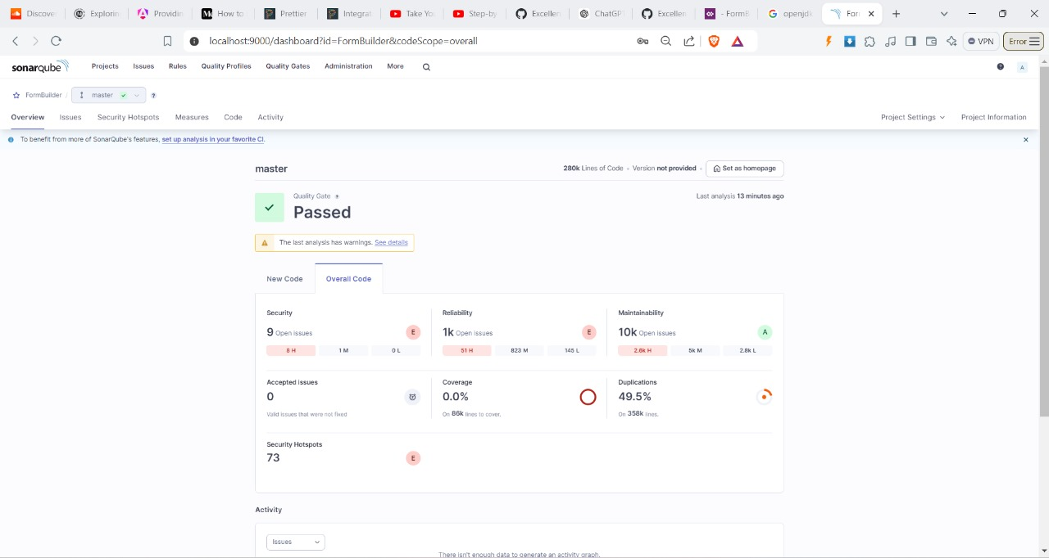
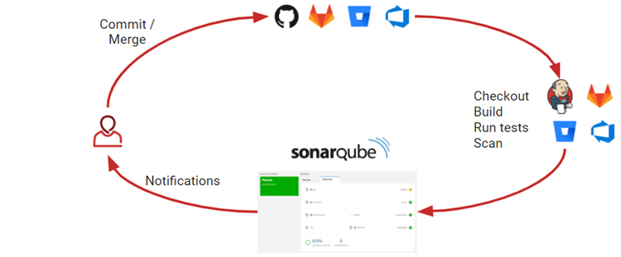
Tools for Code Analysis
SonarQube
Notes:
SonarQube is an open-source platform developed by SonarSource for continuous inspection of code quality.
It performs automatic reviews with static analysis of code to detect bugs, code smells, and security vulnerabilities.
Architectural Implications
Microservices Governance: SonarQube can help maintain consistency across microservices by enforcing uniform code quality standards, crucial for large-scale distributed systems.
Technical Debt Quantification: It provides a "Technical Debt Ratio" metric, allowing architects to quantify and track the long-term impact of design decisions over time.
Architectural Decay Detection: By tracking metrics like coupling and cohesion over time, SonarQube can alert architects to gradual architectural decay that might otherwise go unnoticed.

Slide 96
SonarQube
Pitfalls and Considerations
False Positives
Performance Impact
Security Implications
Notes:
False Positives: Be aware that static analysis can produce false positives. Architects should guide teams on when to use @SuppressWarnings judiciously.
Performance Impact: Large-scale analysis can be resource-intensive. Plan for appropriate hardware allocation, especially in CI/CD pipelines.
Security Implications: While SonarQube can identify many security vulnerabilities, it shouldn't be the sole security measure. Combine it with other security practices and tools.

Slide 97
SonarQube
Metrics for Architectural Decision Making
Cyclomatic Complexity Trending
Package Tangle Index
Code Coverage vs. Complexity
Notes:
Cyclomatic Complexity Trending: Use this to identify parts of the system that are becoming too complex and may need refactoring or redesign.
Package Tangle Index: This lesser-known metric helps identify architectural layers that are becoming too interdependent.
Code Coverage vs. Complexity: Correlate these metrics to identify high-risk areas that are complex but poorly tested.

Slide 98
SonarQube
Long-term Strategic Use
Architectural Fitness Functions
Technical Debt Budgeting
Developer Workflow Integration
Notes:
Architectural Fitness Functions: Use SonarQube metrics as part of your architectural fitness functions to ensure the architecture evolves in the desired direction.
Technical Debt Budgeting: Use the quantified technical debt metrics for informed discussions with stakeholders about allocating resources for code improvement versus new feature development.
Developer Workflow Integration: Beyond CI/CD, integrate SonarQube into IDEs and code review processes to catch issues earlier in the development cycle.

Slide 99

Governing Characteristics
Notes:
Once architects have established architecture characteristics and prioritized them, how can they make sure that developers will respect those priorities?
Modularity is a great example of an aspect of architecture that is important but not urgent; on many software projects, urgency dominates, yet architects still need a mechanism for governance.
Governance is an important responsibility of the architect role.
the scope of architecture governance covers any aspect of the software development process and negligence can lead to disastrous quality problems.
Fortunately, The drive toward automation on software projects spawned by Extreme Programming created continuous integration, which we now call DevOps, continuing through to architectural governance.

Slide 100
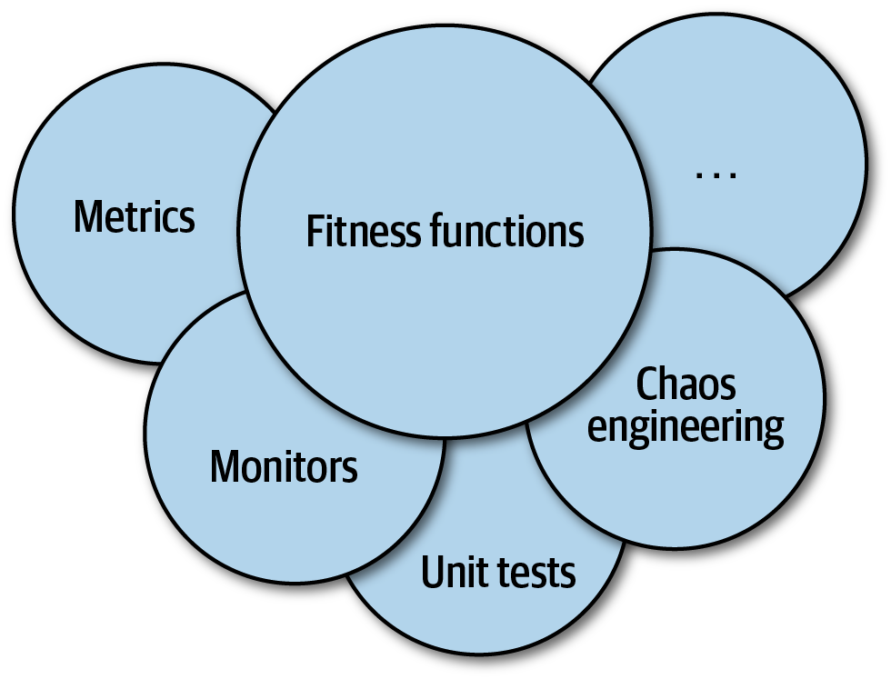
Fitness Functions
Notes:
An architect may want to provide an objective measure indicating the quality of the outcome.
assess some architecture characteristic or combination .. how close the output comes to achieving the aim.

Slide 101
Fitness Functions
Cyclic Dependencies
Poorly maintained modularity
harms the structure of a code base!
Notes:
Modularity is an implicit architecture characteristic that most architects care about, because poorly maintained modularity harms the structure of a code base; thus, architects should place a high priority on maintaining good modularity.
Most programmers develop the habit of swatting the auto-import dialog away like a reflex action. However, importing classes or components between one another spells disaster for modularity.
Remember Always hit remove and sort usings
How can architects govern this behavior without constantly looking over the shoulders of developers? Code reviews help but happen too late.
The solution to this problem is to write a fitness function to look after cycles, as shown in the next example.

Slide 102
Fitness Functions
Cyclic Dependencies
using NUnit.Framework; using System.Collections.Generic; using NetDepend; namespace MyProject.Tests { [TestFixture] public class CycleTest { private NetDepend netDepend; [SetUp] public void Init() { netDepend = new NetDepend(); netDepend.AddDirectory(@"\path\to\project\persistence\classes"); netDepend.AddDirectory(@"\path\to\project\web\classes"); netDepend.AddDirectory(@"\path\to\project\thirdpartyjars"); } [Test] public void TestAllPackages() { var packages = netDepend.Analyze(); Assert.IsFalse(netDepend.ContainsCycles(), "Cycles exist"); } } }
Notes:
Note: Architects must ensure that developers understand the purpose of the fitness function before imposing it on them.

Slide 103
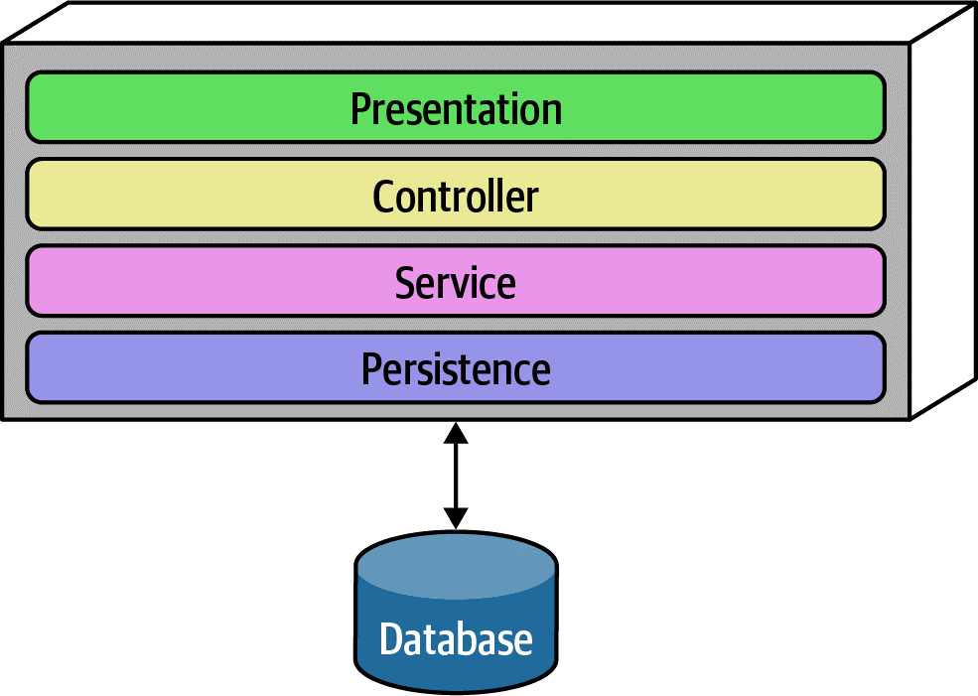
Fitness Functions
How can architects ensure that developers adhere to the intended layered architecture?
Notes:
One such tool is ArchUnit, a Java testing framework. ArchUnit provides a variety of predefined governance rules codified as unit tests and allows architects to write specific tests that address modularity.
When designing a layered monolith, the architect defines the layers for good reason (motivations, trade-offs, and other aspects of the layered architecture). However, how can the architect ensure that developers will respect those layers? Some developers may not understand the importance of the patterns. But allowing implementers to erode the reasons for the architecture hurts the long-term health of the architecture.
ArchUnit allows architects to address this problem via a fitness function by defining the desirable relationship between layers and writing a verification fitness function to govern it, shown in Example.

Slide 104
Scope of Architecture Characteristics
Notes:
we discuss code-level metrics such as cyclomatic complexity. However, all these metrics only reveal low-level details about the code, and cannot evaluate dependent components (such as databases) that still impact many architecture characteristics, , especially operational ones.
For example, no matter how much an architect puts effort into designing a performant or elastic code base, if the system uses a database that doesn’t match those characteristics, the application won’t be successful.
Thus, architects need another method to measure these kinds of dependencies. That led to defining the term architecture quantum. To understand the architecture quantum definition, we must preview one key metric here, connascence.

Slide 105
Connascence
Two components are connascent if a change in one would require the other to be modified in order to maintain the overall correctness of the system.
Notes:
Connascence is a software quality metric & a taxonomy for different types of coupling. such as afferent and efferent coupling, reveal details at a too fine-grained level for architectural analysis.
Two components are connascent if a change in one would require the other to be modified in order to maintain the overall correctness of the system
They defined two types of connascence: static, discoverable via static code analysis, and dynamic, concerning runtime behavior.
For example, if two services in a microservices architecture share the same class definition of some class, like address, we say they are statically connascent with each other—changing the shared class requires changes to both services.
For dynamic connascence, we define two types: synchronous and asynchronous. Synchronous calls between two distributed services have the caller wait for the response from the callee. On the other hand, asynchronous calls allow fire-and-forget semantics in event-driven architectures, allowing two different services to differ in operational architecture.

Slide 106

Architecture Quantum
An independently deployable artifact with high functional cohesion and synchronous connascence.
Notes:
An independently deployable artifact with high functional cohesion and synchronous connascence.
An architecture quantum includes all the necessary components to function independently from other parts of the architecture. For example, if an application uses a database, it is part of the quantum because the system won’t function without it.
However, in the microservices architecture style, each service includes its own database, creating multiple quanta within that architecture.
High Cohesion in component design refers to how well the contained code is unified in purpose. In microservices architectures, developers typically design each service to match a single workflow (a bounded context), thus exhibiting high functional cohesion.
Synchronous connascence: Implies synchronous calls within an application context or between distributed services that form an architecture quantum.
For example, if one service in a microservices calls another one synchronously, and the caller is much more scalable than the callee, timeouts and other reliability concerns will occur. Thus, synchronous calls create dynamic connascence for the length of the call
—if one is waiting for the other, their operational architecture characteristics (such as scalability and elasticity) must be the SAME for the duration of the call (because they are in same quantum so same characteristic level).
For another example, consider a microservices architecture with a Payment service and an Auction service. When an auction ends, the Auction service sends payment information to the Payment service. However, let’s say that the payment service can only handle a payment every 500 ms—what happens when a large number of auctions end at once? => We considered initially that Auction and payment services are in same quantum .. Although they have no cohesion together.. A poorly designed architecture would allow the first call to go through and allow the others to time out.
=> Alternatively, an architect might design an asynchronous communication link between Payment and Auction, allowing the message queue to temporarily buffer differences. In this case, asynchronous connascence creates a more flexible architecture.
What architect did here is analyzed and found that they are not achieving the one quantum together correctly and also no high functional cohesion between each other.
=> So async connascence made a separation of quanta. And better characteristic for each quanta such improved scalability and reliability in payment service.

Slide 107
Fundamentals of Software Architecture Part 2 - A book by Neal Ford and Mark Richards
From developer to architect: Key concepts for the transition

Slide 108
CONTENTS
Here’s what you’ll learn:
Bounded Context
Component-Based Thinking
Architecture Styles Introduction
Layered Architecture Style
Microservice Architecture

Slide 109

Bounded Context
(Domain Driven Design)
Notes:
Terms and Sentences can mean different things
Context Matters
A metaphor is green field with different types of crop, like wheat, vegetables, or flowers. Each crop area requires different soil conditions, watering schedules, and care methods. For instance, fruit trees need more sunlight, while vegetables might need more frequent watering. In software, each bounded context has its own models, rules, and data that are optimized for its specific domain.
The boundaries between the crop areas are clear, ensuring that the specific needs of one crop don’t interfere with another.
Despite the differences, all areas of the field work together to create a productive and healthy environment.
Before DDD, developers creating common shared artifacts caused a host of problems, such as coupling, more difficult coordination, and increased complexity. The bounded context concept recognizes that each entity works best within a localized context.
The architecture quantum concept provides the new scope for architecture characteristics. In modern systems, architects define architecture characteristics at the quantum level.
By looking at a narrower scope Bounded Contexts for important operational concerns, architects may identify architectural challenges early, leading to hybrid architectures.

Slide 110
"ubiquitous language"
Notes:
— a shared vocabulary that ensures clear communication and separation

Slide 111
Bounded Context
Easier to manage business complexity
Notes:
Easier to manage complexity and integrate various components effectively

Slide 112
Bounded Context
Microservice Decomposition
the transition from a monolithic architecture to a microservices-based approach
Notes:
a detailed case study… , aimed at improving both maintainability and scalability. This case study will highlight the strategic use of Bounded Context as a methodological framework for facilitating this migration.

Slide 113
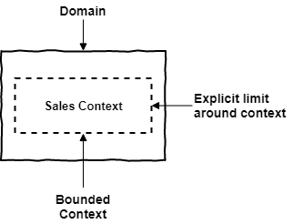
Bounded Context
Notes:
Bounded Context is where the Model is implemented

Slide 114
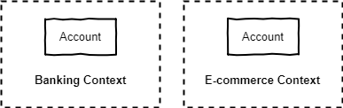
Bounded Context
Notes:
easy to identify that ‘Account‘ has different meanings in these two contexts.
In banking : ‘Account‘ refers to subjects such as money, transactions, payments, credit, and may belong to a person or company.
In e-commerce, ‘Account‘ refers to subjects such as login, account creation, password change and so on.

Slide 115
Domains and Subdomains
a sphere of knowledge or activity in the real world
But why does decomposition matter??
Notes:
has its own language, concepts, rules, and practices
e-commerce platform. The subdomain of “Order Management” can be further decomposed into smaller subdomains such as “Shopping Cart Management”, “Payment Processing”, “Shipping and Logistics”, and “Order Fulfillment”, etc.
The level of decomposition depends on the complexity of the business domain
Decomposition is necessary to manage the complexity of large software systems.\
into smaller subdomains, the team can better understand the business requirements and the software’s behavior.
developed and updated independently, which allows for greater agility and flexibility in responding to changing business needs.
subdomains can be assigned to different teams

Slide 116
Bounded Contexts and Subdomains
Subdomains live in the space of the problem and
the Bounded Contexts in the solution space.
Notes:
It is only natural when we start studying DDD that we find content that makes it difficult to differentiate between Bounded Contexts and Subdomains, since they both represent “segregation”.
Subdomains live in the space of the problem and the Bounded Contexts in the solution space.
Subdomains are logical “separations” of the domain and Bounded Contexts are technical solutions.

Slide 117
Bounded Contexts and Subdomains
Subdomain of order fulfillment
shipping system
returns system
warehouse management
Notes:
Example
Now, let’s take the subdomain of order fulfillment as an example. Within order fulfillment, there could be several bounded contexts, such as the shipping system, the returns system, and the warehouse management system. Each of these bounded contexts would have their own specific models, language, and rules that are distinct from the other bounded contexts within the same subdomain.
Yes, duplication can happen across bounded contexts, especially for entities that exist in multiple contexts but have different attributes or behavior.

Slide 118
Bounded Context Recommendations
Team assigned to a Bounded Context
Separate repository
One to many relationship
Notes:
Teams and Source Code Repositories :
There must be a team assigned to work on a Bounded Context.
There should be a separate source code repository for each Bounded Context.
It is possible that one team can work in several Bounded Context, but several teams should not work in a single Bounded Context.

Slide 119
Characteristic Scope
Case Study: Going, Going, Gone
Description:
An auction company wants to take its auctions online to a nationwide scale. Customers choose the auction to participate in, wait until the auction begins, then bid as if they are there in the room with the auctioneer.
Users:
Scale up to hundreds of participants per auction, potentially up to thousands of participants, and as many simultaneous auctions as possible.
Requirements:
Auctions must be as real-time as possible.
Bidders register with a credit card; the system automatically charges the card if the bidder wins.
Participants must be tracked via a reputation index.
Bidders can see a live video stream of the auction and all bids as they occur.
Both online and live bids must be received in the order in which they are placed.
Additional context:
The auction company is expanding aggressively by merging with smaller competitors.
The budget is not constrained. This is a strategic direction.
The company just exited a lawsuit where it settled a suit alleging fraud.

Slide 120
Characteristic Scope
Case Study: Going, Going, Gone
“Nationwide scale,”
“scale up to hundreds of participants per auction, potentially up to thousands of participants, and as many simultaneous auctions as possible,”
“auctions must be as real-time as possible.”
Notes:
An architect must consider each of these requirements to ascertain architecture characteristics:
Each of these requirements implies both scalability and elasticity. While the requirements explicitly call out scalability, elasticity represents implicit characteristics. When considering auctions, do users all politely spread themselves out during the course of bidding, or do they become more frantic near the end? Domain knowledge is crucial for architects to pick up implicit architecture characteristics. Given the real-time nature of auctions, an architect will certainly consider performance a key architecture characteristic.

Slide 121
Characteristic Scope
Case Study: Going, Going, Gone
“Bidders register with a credit card; the system automatically charges the card if the bidder wins,”
“company just exited a lawsuit where it settled a suit alleging fraud.”
Notes:
Both these requirements clearly point to security which is an implicit architecture characteristic in virtually every application. Should an architect design something special to accommodate security, or will general design and coding hygiene suffice? For example, as long as developers make sure not to store credit card numbers in plain text, to encrypt while in transit, and so on, then the architect shouldn’t have to build special considerations for security.
However, the second phrase should make an architect pause and ask for further clarification. Clearly, some aspect of security (fraud) was a problem in the past, thus the architect should ask for further input no matter what level of security they design.

Slide 122
Characteristic Scope
Case Study: Going, Going, Gone
“Participants must be tracked via a reputation index.”
“Auction company is expanding aggressively by merging with smaller competitors.”
Notes:
The track part of this requirement might suggest characteristics such as auditability and loggability. The deciding factor again goes back to the defining characteristic—is this outside the scope of the problem domain? Architects must remember that yielding architecture characteristics represents only a small part of the overall effort to design .
“Auction company is expanding aggressively by merging with smaller competitors.”
This requirement may not have an immediate impact on application design, it might become the determining factor in a trade-off like choosing details such as communication protocols for integration architecture if integration with newly merged companies is a concern.

Slide 123
Characteristic Scope
Case Study: Going, Going, Gone
“Bidders can see a live video stream of the auction and all bids as they occur,”
“both online and live bids must be received in the order in which they are placed.”
Notes:
This requirement presents an interesting architectural challenge, definitely impacting the structure of the application.
Is the availability of the one auctioneer more important than availability for one of the hundreds of bidders?
Obviously, one is clearly more critical: if the auctioneer cannot access the site, online bids cannot occur for anyone.
Reliability commonly appears with availability; it addresses operational aspects such as uptime, as well as data integrity and other measures of how reliable an application is. For example, in an auction site, the architect must ensure that the message ordering is reliably correct.
This last requirement highlights the need for using the architecture quantum measure as architects scope architecture characteristics at the quantum level. For example, in Going, Going, Gone, an architect would notice that different parts of this architecture need different characteristics: streaming bids, online bidders, and the auctioneer are three obvious choices. The architecture quantum measure is a way to think about deployment, coupling, where data should reside, and communication styles within architectures. In this kata, an architect can analyze the differing architecture characteristics per architecture quantum, leading to hybrid architecture design earlier in the process.

Slide 124

Component-Based Thinking
Notes:
architects typically think in terms of components, the physical manifestation of a module.
Developers physically package modules in different ways as we call components such as DLL files in .Net or JAR files in Java.
So we will discuss architectural considerations around components, ranging from scope to discovery.

Slide 125
Component Scope
Library
Service
Fundamental modular building blocks in architecture
Notes:
The simplest component is a wrapper that is often called a library which represents a higher level of modularity. It tends to run in the same memory address as the calling code and communicate via language function call mechanisms.
Components also appear as subsystems or layers in architecture.
Libraries are usually compile-time dependencies.
Another type of component, a service, tends to run in its own address space and communicates via low-level networking protocols like TCP/IP or higher-level formats like REST or message queues, forming stand-alone, deployable units in architectures like microservices.
Components, as the fundamental modular building blocks in architecture, are a critical consideration for architects, particularly in making decisions regarding the top-level partitioning within the architecture.

Slide 126
Architect Role
Defines, refines, manages, and governs components within an architecture,
and in collaboration with …
Notes:
Typically, the architect defines, refines, manages, and governs components within an architecture. Software architects, in collaboration with business analysts, subject matter experts, developers, QA engineers, operations, and enterprise architects,
incorporating the architecture characteristics and the requirements for the software

Slide 127
Architect Role
Architecture
Is independent from
Development process
Notes:
Virtually, architecture is independent from the development process, The primary exception is various flavors of Agile
Architects ultimately don’t care where requirements originate: waterfall-style analysis and design, Agile story cards...
Components consist of classes or functions, whose design falls under the responsibility of tech leads or developers.
Architects just should avoid micromanaging each decision from top to bottom in the system.
If architects never allow other roles to make decisions of consequence, the organization will struggle with empowering the next generation of architects.
An architect must identify components as one of the first tasks on a new project. But before an architect can identify components, they must know how to partition the architecture.

Slide 128
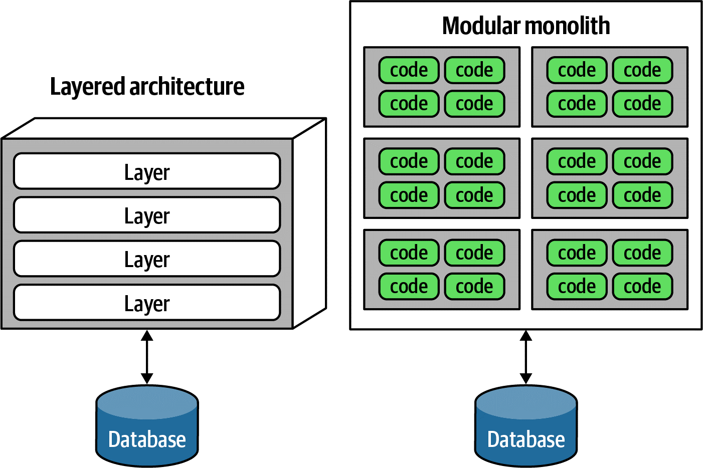
Architecture Partitioning
Notes:
Several common styles of top-level portioning exist, with different sets of trade-offs.
The top-level partitioning defines the fundamental architecture style and way of partitioning code.
The modular monolith, partitioned around domains rather than technical capabilities.
both represent different ways to top-level partition the architecture.
The Model-View-Controller design pattern matches with layered architecture, making it easy for developers to understand. often the default architecture in many organizations.

Slide 129
Conway's Law
Organizations which design systems … are constrained to produce designs which are copies of the communication structures of these organizations.
Notes:
An interesting side effect of the predominance of the layered architecture is that it makes some sense to have all the backend developers sit together in one department, the DBAs in another, the presentation team in another, and so on. Because of Conway’s law, this makes some sense.
This law suggests that when a group of people designs some technical artifact, the communication structures between the people end up replicated in the design. People at all levels of organizations see this law in action, and they sometimes make decisions based on it.
A well-designed architecture aligns with the organizational structure, promoting clearer communication, better-defined roles, and more efficient collaboration and resource allocation.

Slide 130
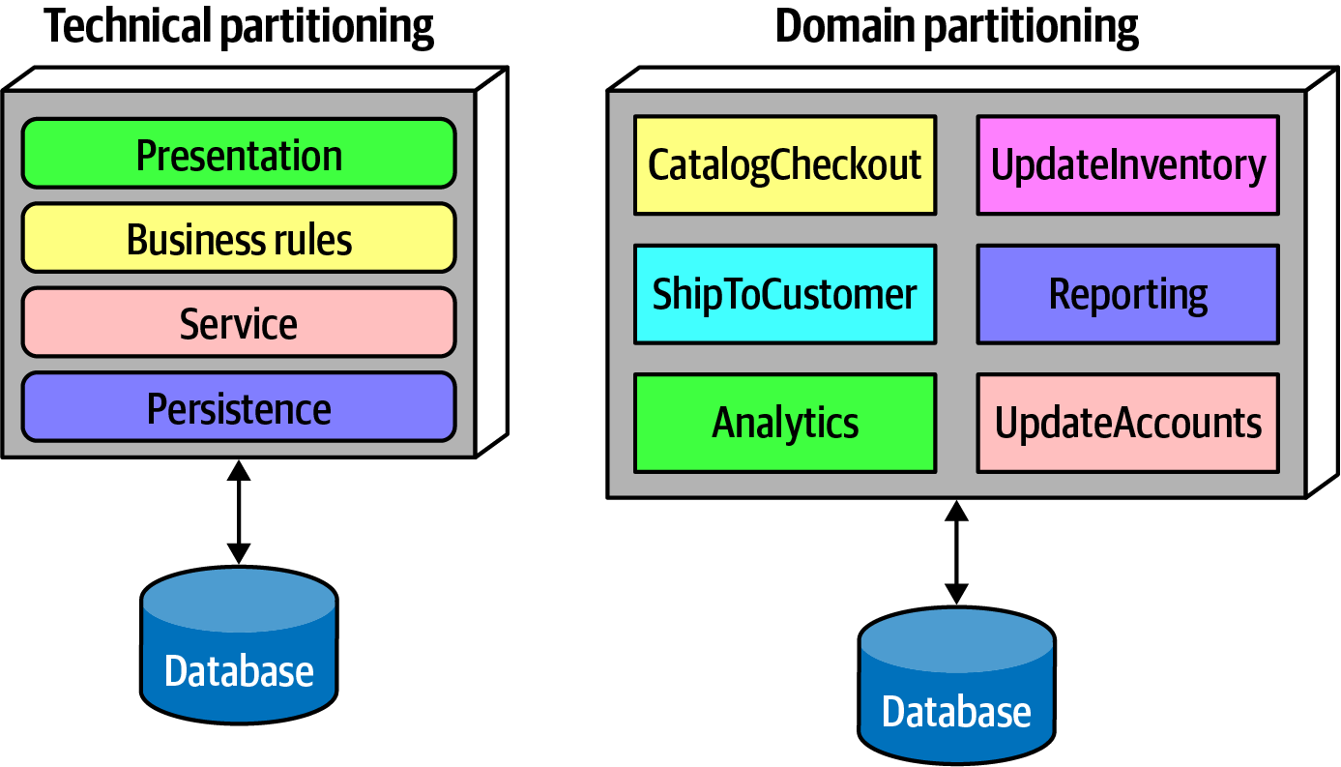
Architecture Partitioning
Notes:
Domain Partitioning
In DDD, the architect identifies domains or workflows independent and decoupled from each other.
The microservices architecture style is based on this philosophy.
In a modular monolith, the architect partitions the architecture around domains or workflows rather than technical capabilities.
As components often nest within one another, each of the components in Figure in the domain partitioning (for example, CatalogCheckout) may use its own persistence library and have a separate layer for business rules, but the top-level partitioning revolves around domains.
One of the fundamental distinctions between different architecture patterns is what type of top-level partitioning each supports.
Does the architect want to partition things technically or by domain?

Slide 131
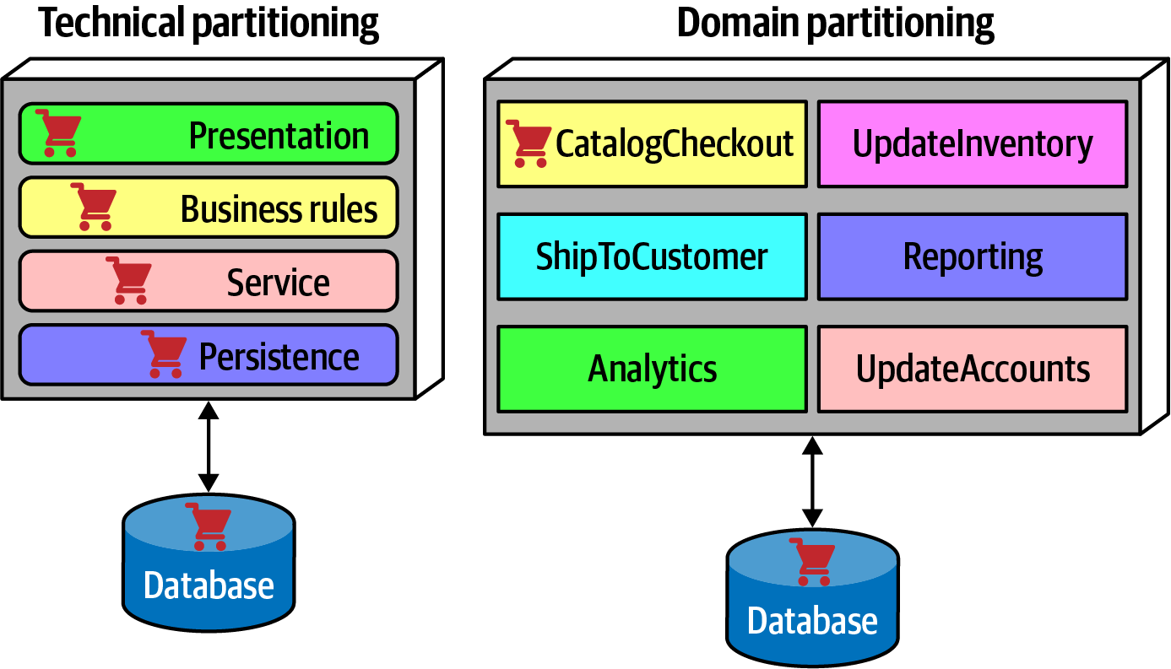
Architecture Partitioning
Notes:
Technical partitioning has one of the organizing principles which is separation of technical concerns. This in turn creates useful levels of decoupling: if the service layer is only connected to the persistence layer below and business rules layer above, then changes in persistence will only potentially affect those layers. It is certainly logical to organize systems using technical partitioning, but of course this offers some trade-offs.
The separation enforced by technical partitioning enables developers to find certain categories of the code base quickly.
However, most realistic software systems require workflows that cut across technical capabilities.
The code to handle CatalogCheckout in the technically layered architecture appears in all the layers.
Contrast this with domain partitioning, which uses a top-level partitioning by domain. Each component in the domain partitioning may have subcomponents, including layers.
Neither of these styles is more correct than the other—refer to the First Law of Software Architecture. That said, we have observed a decided industry trend over the last few years toward domain partitioning for the monolithic and distributed (for example, microservices) architectures. However, it is one of the first decisions an architect must make.

Slide 132
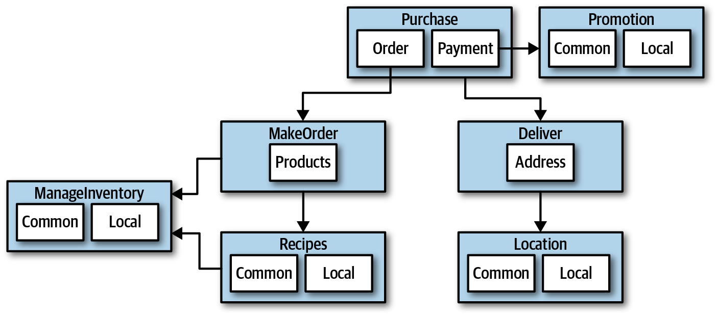
Case Study: Silicon Sandwiches: Partitioning
Notes:
one of the fundamental decisions facing an architect is the top-level partitioning.
The architect has designed around Domains (workflows), creating discrete components for Purchase, Promotion, MakeOrder,...
Within many of these components resides a subcomponent to handle the various types of customization required (ex : local and common subcomponents).
An alternative design isolates the common and local parts into their own partition, illustrated in the next Figure.

Slide 133
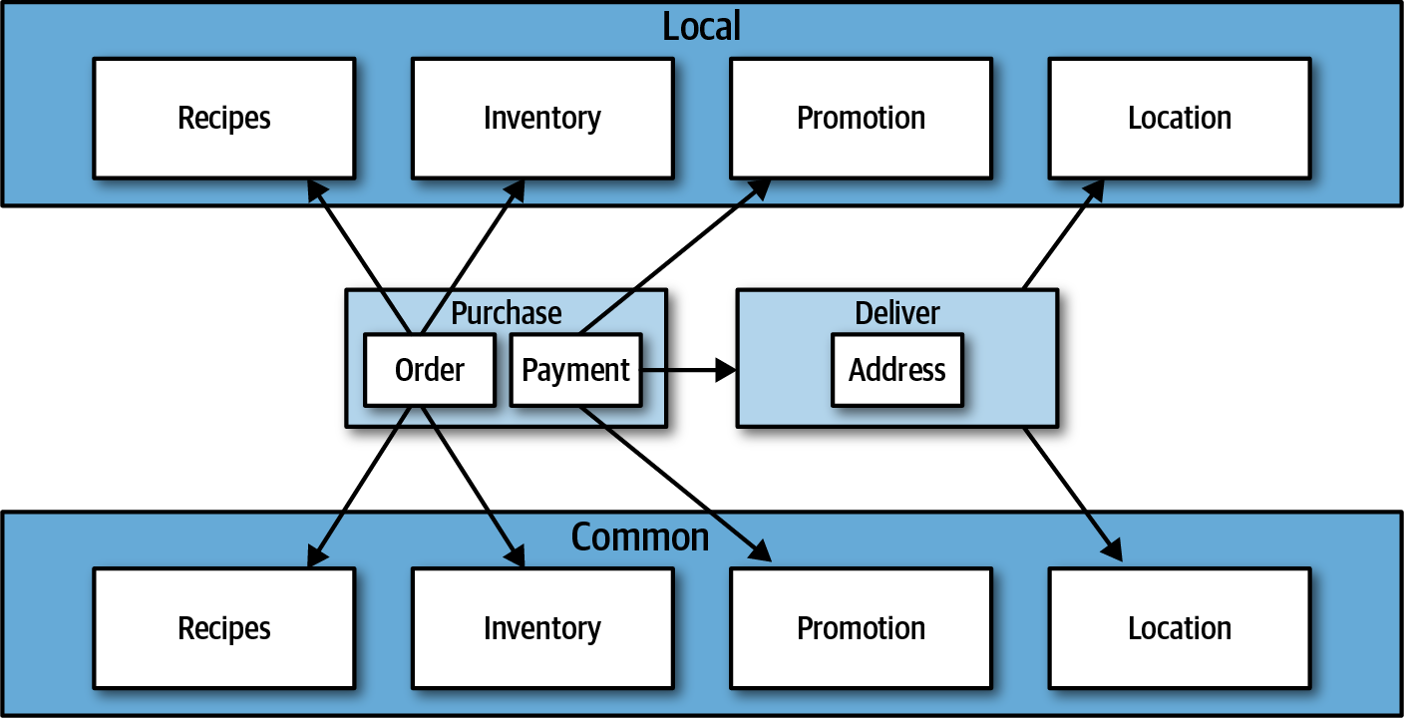
Case Study: Silicon Sandwiches: Partitioning
Notes:
Common and Local represent top-level components, with Purchase and Delivery remaining to handle the workflow.
Which is better? It depends! Each partitioning offers different advantages and drawbacks.

Slide 134
Case Study: Silicon Sandwiches: Partitioning
Technical Partitioning
Domain Partitioning
Which is better? It depends!
Notes:
Domain partitioning
Domain-partitioned architectures separate top-level components by workflows and/or domains.
Advantages
Focus on how the business functions and message flow matches the problem domain.
Easier to build cross-functional teams around domains (Conways’ Law) (Cross-functional teams bringing together members from different functional areas.).
Easy to be aligned and migrate data and components to distributed architecture (the modular monolith and microservices architecture styles). Disadvantage
Customization code appears in multiple places.

Slide 135
Case Study: Silicon Sandwiches: Partitioning
Technical Partitioning
Domain Partitioning
Which is better? It depends!
Notes:
Technical partitioning
Technically partitioned architectures separate top-level components based on technical capabilities. This may manifest as layers inspired by Model-View-Controller separation. In Example it separates components based on customization.
Advantages
Clearly separates customization code.
Aligns more closely to the layered architecture pattern.
Disadvantages
Higher degree of global coupling as changes to local or common components may affect all the others.
For ex : calculateDiscount in local changed , it will affect or need required modification to some domains code parts .
Developers may have to duplicate domain concepts in both common and local layers.
Typically higher coupling at the data level. In a system like this, the architects would likely create a single database, including customization and domains. That in turn creates difficulties in untangling the data relationships if the architects later want to migrate this architecture to a distributed system.

Slide 136

Developer Role
Class and function design is a shared responsibility
Notes:
Developers typically take components, designed with the architect role, and further subdivide them into classes, functions, or subcomponents. In general, class and function design is the shared responsibility of architects, tech leads, and mostly developers.
Developers should never take components designed by architects as the last word; all software design benefits from iteration. Rather, that initial design should be viewed as a first draft, where implementation will reveal more details and refinements.

Slide 137
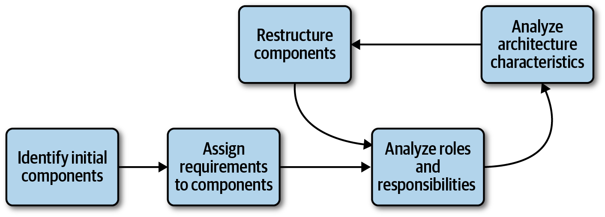
Component Identification Flow
Iterative approach makes it almost perfect
Notes:
Component identification works best as an iterative process, producing candidates and refinements through feedback..
Identifying Initial Components
Before any code exists, the architect must determine what TOP-Level components to begin with, based on partitioning they choose.
Initially, An architect should map domain functionality to the components to see where behavior should reside.
Also The likelihood of achieving a good design from this initial is small, that’s why architects must iterate to improve.
an architect should map domain functionality to the components to see where behavior should reside.
Align Requirements to Components (More deeply)
The next step aligns requirements (or user stories) to those components to see how well they fit.
This may entail creating new components, consolidating existing ones, or breaking components apart because they have too much responsibility.
also think about the roles, responsibilities and behaviors to align the components and domain correct granularity as it one of the greatest challenges ,solved by the iterative approach.
Analyze Architecture Characteristics
the architect should also look at the architecture characteristics discovered earlier in order to think about how they might impact component division and granularity. For example, while two parts of a system might deal with user input, the part that deals with hundreds of concurrent users will need different architecture characteristics than another part that needs to support only a few. Thus, it might yield a single component to handle user interaction, analyzing the architecture characteristics will lead to a subdivision.
Restructure Components with developers
Feedback is critical in software design. Thus, architects must continually iterate on their component design with developers. First, it’s impossible to account for all the different edge cases. Secondly, as the architecture and developers delve more deeply into building the application, they gain a more nuanced understanding of where behavior and roles should lie.

Slide 138
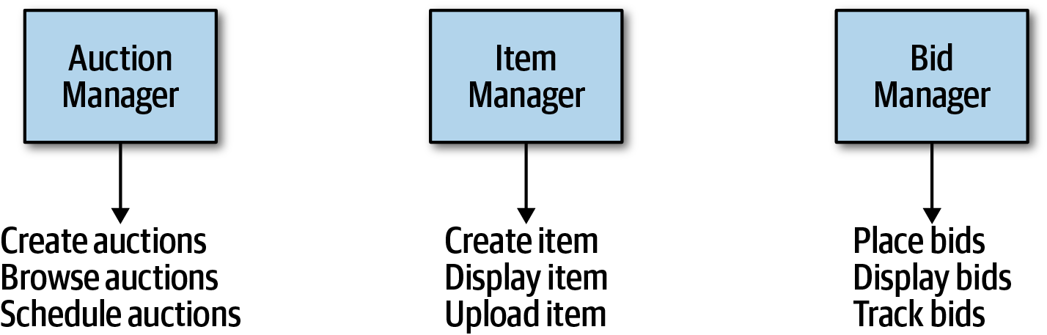
Component Design
Entity Trap
Notes:
No accepted “correct” way exists to design components. Rather, a wide variety of techniques exist, all with various trade-offs.
A common anti-pattern may lurk: the entity trap. Say that an architect is working on designing components for kata Going, Going, Gone and ends up with that figure.
The architect has basically taken each entity identified in the requirements and made a Manager component based on that entity.
This isn’t an architecture; it’s an object-relational mapping (ORM) of a framework to a database.
The entity trap anti-pattern arises when an architect incorrectly identifies the database relationships as workflows in the application which indicates lack of thought about the actual workflows.

Slide 139
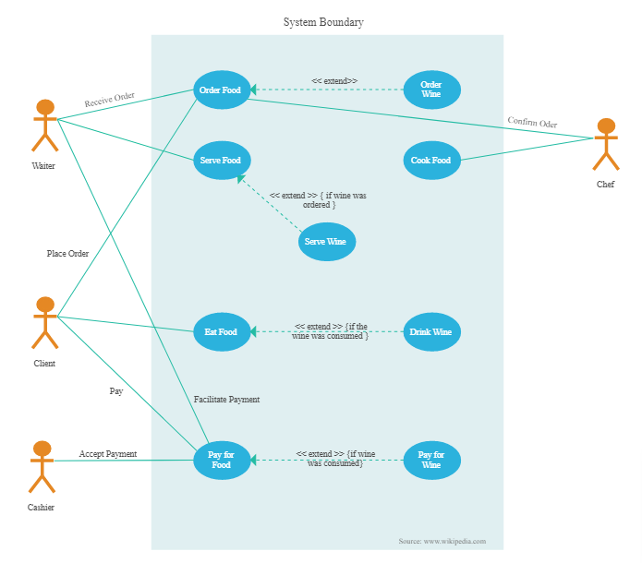
Component Design
Actor/Actions approach
Notes:
The actor/actions approach is a popular way that architects use to map requirements to components. In this approach, originally defined by the Rational Unified Process Called Use Case Diagram, architects identify actors/users who perform activities with the application and the actions those actors may perform.
This style of component decomposition works well for all types of systems, monolithic or distributed.

Slide 140
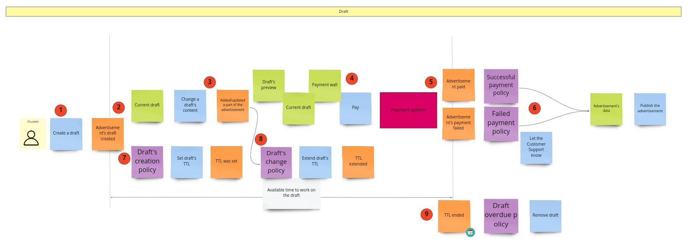
Component Design
Event storming
Notes:
/// Todo : Need revision on the actual difference between it and the workflow approach (flow chart)
Event storming as a component discovery technique comes from domain-driven design (DDD) and shares popularity with microservices. In event storming, the architect assumes the project will use messages and/or events to communicate between the various components. The team tries to determine which events occur in the system based on requirements and identified roles, and build components around those event and message handlers. This works well in distributed architectures like microservices that use events and messages, because it helps architects define the messages used in the eventual system.

Slide 141
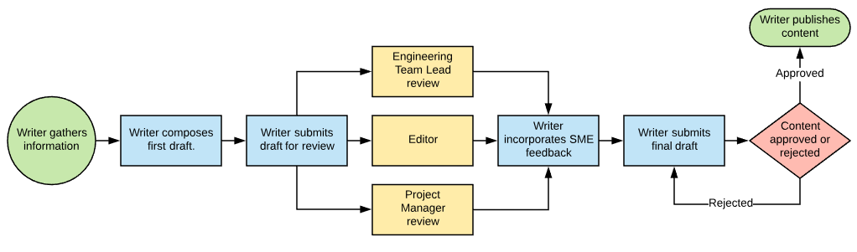
Component Design
Workflow Approach
Notes:
An alternative to event storming not using DDD or messaging. The workflow approach is by identifying the key roles and their workflows and modeling the components around these workflows, much like event storming, but without the explicit constraints of building a message-based system.
None of these techniques is superior to the others; all offer a different set of trade-offs. If a team uses a waterfall approach, they might prefer the Actor/Actions approach because it is general. When using DDD and corresponding architectures like microservices, event storming matches the software development process exactly.

Slide 142
Case Study: Going, Going, Gone: Discovering Components
Bidder
View live video stream, view live bid stream, place a bid
Auctioneer
Enter live bids into system, receive online bids, mark item as sold
System
Start auction, make payment, track bidder activity
Notes:
The Actor/Actions approach works well as a generic solution. It’s the one we use.
In Chapter “Scope of Architecture characteristics”, we discussed the architecture kata for Going, Going, Gone (GGG) and discovered architecture characteristics for this system.
Three obvious roles: the bidder, the auctioneer, and a frequent participant and the system, for internal actions.
For example , once the auction is complete, the system triggers the payment system to process payments.
a starting set of actions for each of these roles:

Slide 143
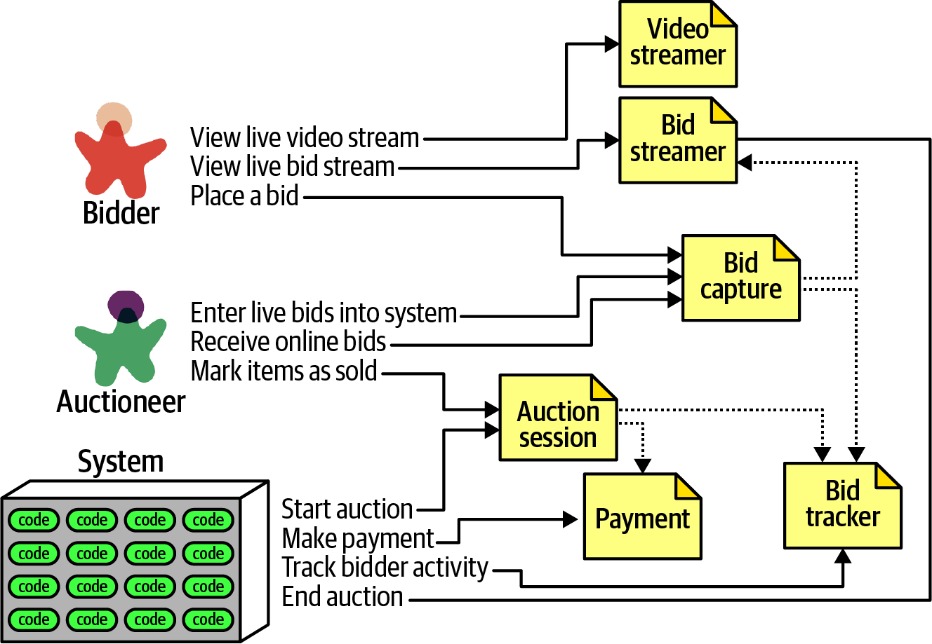
Case Study: Going, Going, Gone: Discovering Components
Notes:
Given these actions, we can iteratively build a set of starter components for GGG
each of the roles and actions maps to a component.
These are the components identified:
VideoStreamer
Streams a live auction to users. BidStreamer
Streams bids as they occur to the users. Both VideoStreamer and BidStreamer offer read-only views of the auction to the bidder.
BidCapture
This component captures bids from both the auctioneer and bidders.
BidTracker
Tracks bids and acts as the system of record.
AuctionSession
Starts and stops an auction. When the bidder ends the auction, performs the payment and resolution steps, including notifying bidders of the ending.
Payment
Third-party payment processor for credit card payments.
after the initial identification of components, the architect next analyzes architecture characteristics to determine if that will change the design.
what about architecture characteristics around bid capture? The auctioneer doesn’t need the same level of scalability or elasticity as potentially thousands of bidders.
An architect should also ensure that characteristics like reliability (connections don’t drop) and availability (the system is up) for the auctioneer could be higher than other parts of the system.

Slide 144
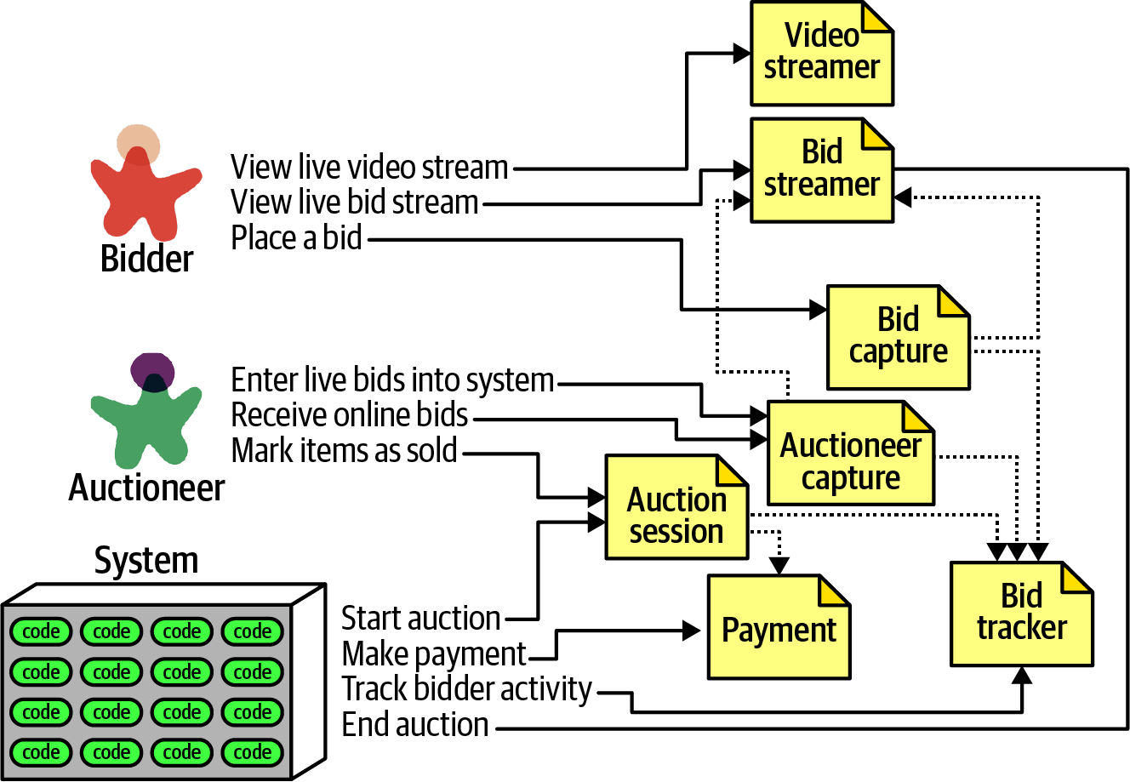
Case Study: Going, Going, Gone: Discovering Components
Notes:
Because they have differing levels of architecture characteristics, the architect decides to split the Bid Capture component into Bid Capture and Auctioneer Capture.
Note that Bid Tracker will unify the two very different information streams from Bid capture and Auctioneer Capture.
This design isn’t likely the final design but a good starting point .
As an architect, don’t obsess over finding the one true design, because many will suffice (and less likely overengineered).
Rather, try to objectively assess the trade-offs between different design decisions, and choose the one that has the least worst set of trade-offs.

Slide 145

Architecture Style
Notes:
The difference between an architecture style and an architecture pattern can be confusing.
We define an architecture style as the overarching structure of how the user interface and backend source code are organized and how that source code interacts with a datastore. Architecture design patterns, on the other hand, are lower-level design structures that help form specific solutions within an architecture style (such as how to achieve high scalability or high performance between sets of services).
Architects must understand the various styles and the trade-offs encapsulated within each to make effective decisions for each particular business problem.

Slide 146

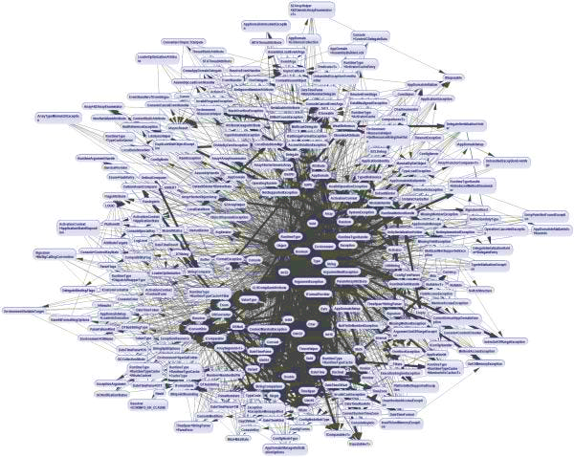
Fundamental Style Patterns Not Design Patterns!
Big Ball of Mud
Notes:
Architects refer to the absence of any discernible architectural structure as a Big Ball of Mud (anti-pattern).
a simple scripting application with event handlers wired directly to database calls, with no real internal structure. Many trivial applications start like this then become unwieldy as they continue to grow.
In general, architects want to avoid this type of architecture at all costs. The lack of structure makes change increasingly difficult. This type of architecture also suffers from problems in deployment, testability, scalability, and performance and many others.

Slide 147
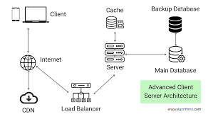
Fundamental Style Patterns Not Design Patterns!
Client/Server
Notes:
Unitary Architecture (optional to talk about)
When software originated, there was only the computer, and software ran on it as single machine (no network).
Client/Server
A fundamental style in architecture separates technical functionality between frontend and backend, called a two-tier, or client/server, architecture. Many different flavors of this architecture exist, depending on the era and computing capabilities. Such as Desktop app or Browser+ database server + web server + load balancer....

Slide 148
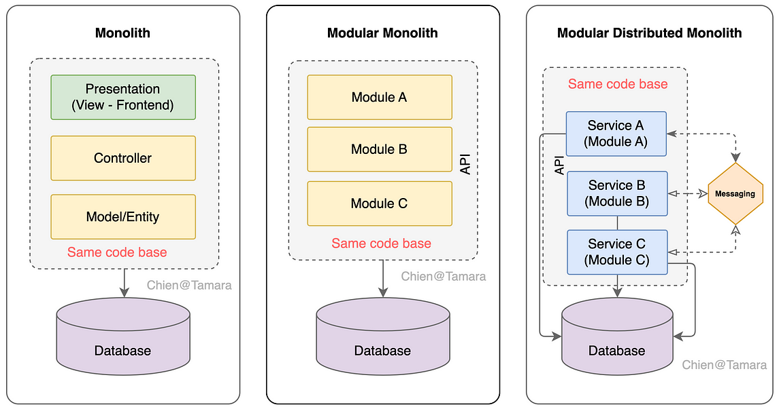
Monolithic Versus Distributed Architectures
Notes:
Architecture styles can be classified into two main types: monolithic (single deployment unit of all code) and distributed (multiple deployment units connected through remote access protocols).
Distributed architecture styles, while being much more powerful in terms of performance, scalability, and availability than monolithic architecture styles, have significant trade-offs for this power which is the fallacies of distributed computing.
A fallacy is something that is believed or assumed to be true but is not.
Monolithic
Layered architecture
Pipeline architecture
Microkernel architecture
Distributed
Service-based architecture
Event-driven architecture
Space-based architecture
Service-oriented architecture
Microservices architecture

Slide 149
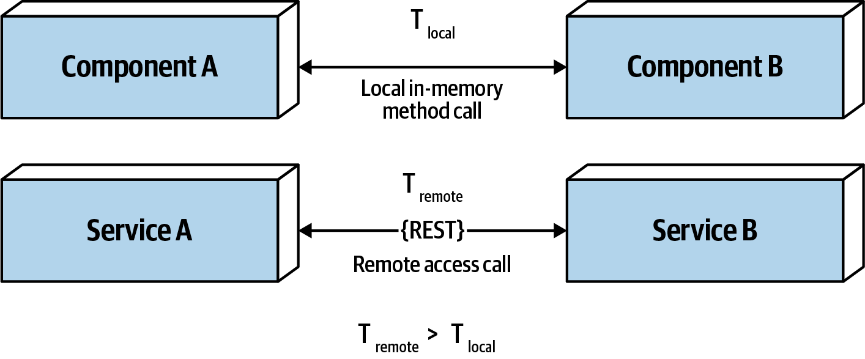
Distributed Architecture Fallacies
Fallacy #1: The Network Is Reliable
Fallacy #2: Latency Is Zero
Notes:
Developers and architects alike assume that the network is reliable, but it is not. While networks have become more reliable over time, the fact of the matter is that networks still remain generally unreliable.
This is significant for all distributed architectures because rely on the network for communication to, from and between services.
This is why things like timeouts and circuit breakers exist between services.
Fallacy #2: Latency Is Zero
when a local call is made to another component via a method or function call, that time (t_local) is measured in nanoseconds or microseconds. However, when that same call is made through a remote access protocol (such as REST, messaging, or RPC) t_remote is measured in milliseconds.
Therefore, t_remote will always be greater than t_local. Latency in any distributed architecture is not zero, yet most architects ignore this fallacy. When using any distributed architecture, architects must know this latency average. It is the only way of determining whether a distributed architecture is feasible, particularly microservices because of the amount of communication between those services. For example, assuming an average of 200 milliseconds of latency per request, chaining together 10 service calls adds 2,000 milliseconds to the request!.

Slide 150
Distributed Architecture Fallacies
Fallacy #3: Bandwidth Is Infinite
Notes:
Bandwidth is usually not a concern in monolithic architectures as little or no bandwidth is required to process that business request.
But in a distributed architecture such as microservices, communication to and between these services significantly utilizes bandwidth, impacting latency (fallacy #2) and reliability (fallacy #1).
To illustrate the importance of this fallacy, consider two services. Let’s say a service manages the wish list items for the website, and a service manages the customer profile. Whenever a request for a wish list comes, it must make an interservice call to the customer profile service to get the customer name in the wish list response contract.
The customer profile service returns data totaling 500 kb to the wish list service, which only needs the name (200 bytes). This is a form of coupling referred to as stamp coupling. Requests for the wish list items happen about 2,000 times a second. The total amount of bandwidth used for that one interservice call is 1 Gb!
#Solution : If the customer profile service were to only pass back the data needed by the wish list service (200 bytes), the total bandwidth is only 400 kb.
Stamp coupling can be resolved in the following ways:
Create private RESTful API endpoints
Use field selectors in the contract
Use GraphQL to decouple contracts
Use value-driven contracts with consumer-driven contracts (CDCs)
Use internal messaging endpoints
Regardless of the technique used, ensuring that the minimal amount of data is passed between services or systems in a distributed architecture is the best way to address this fallacy.

Slide 151
Distributed Architecture Fallacies
Fallacy #4: The Topology Never Changes
Notes:
This fallacy refers to the overall network topology, including all of the routers, hubs, switches, firewalls, networks,.. the overall network. Architects assume that the topology is fixed and never changes. Of course it changes. What is the significance of this fallacy?
Suppose an architect comes into work on a Monday morning, and everyone is running around like crazy because Suddenly services keep timing out in production. The architect works with the teams, trying to figure out why this is happening. No new services were deployed over the weekend. What could it be? the architect discovers that a minor network upgrade happened at 2 a.m. that morning. This supposedly “minor” network upgrade invalidated all of the latency assumptions, triggering timeouts and circuit breakers.
Architects must be in constant communication with operations and network administrators to know what is changing to reduce the type of surprise.
Architects all the time assume they only need to collaborate and communicate with one administrator.
There are dozens of network administrators in a typical large company.
This fallacy points to the complexity of distributed architecture and the amount of coordination that must happen to get everything working correctly. Monolithic applications do not require this level of communication and collaboration due to the single deployment unit characteristics of those architecture styles.

Slide 152
Distributed Architecture Fallacies
Fallacy #5: Transport Cost Is Zero
Notes:
Transport cost here refer to actual cost in terms of money associated with making a “simple RESTful call”. Distributed architectures cost significantly more than monolithic architectures, primarily due to increased needs for additional hardware, servers, gateways, firewalls, new subnets, proxies, and so on.

Slide 153
Monolithic Versus Distributed Architectures
Distributed Logging
Distributed Transactions
Notes:
Distributed logging
Performing root-cause analysis to determine why a particular order was dropped is very difficult and time-consuming in a distributed architecture due to the distribution of application and system logs (contain dozens to hundreds of different logs , places , in formats).
Logging consolidation tools such as Splunk or (ELK Stack (Elasticsearch, Logstash, Kibana)) help to consolidate information from various sources and systems together into one consolidated log and console.
Distributed transactions
Architects and developers take transactions for granted in a monolithic architecture world because they are so straightforward and easy to manage. Standard commits and rollbacks executed from persistence frameworks leverage ACID (atomicity, consistency, isolation, durability) transactions to ensure high data consistency and integrity.
Such is not the case with distributed architectures.
Distributed architectures rely on what is called EVENTUAL consistency to ensure the data processed by separate deployment units into a consistent STATE.
This is one of the trade-offs of distributed architecture: high scalability, performance, and availability at the sacrifice of data consistency and data integrity.
Transactional sagas (architectural design pattern) are one way to manage distributed transactions. Sagas utilize either event sourcing to manage the state of transactions.
The implementation of transactional sagas in code depends on the chosen approach (choreography or orchestration) and the specific architecture of your system.

Slide 154

Layered Architecture
Notes:
The layered architecture, also known as the n-tiered architecture style, is one of the most common architecture styles. This style of architecture is the de facto standard for most applications, primarily because of its simplicity, familiarity, and low cost.
It is also a very natural way to develop applications due to Conway’s law as in most organizations there are user interface (UI) developers, backend developers, rules developers, and database experts (DBAs). These organizational layers fit nicely into the tiers of a traditional layered architecture.
If a developer or architect is unsure which architecture style they are using, or if an Agile development team “just starts coding,” chances are good that it is the layered architecture style they are implementing.

Slide 155

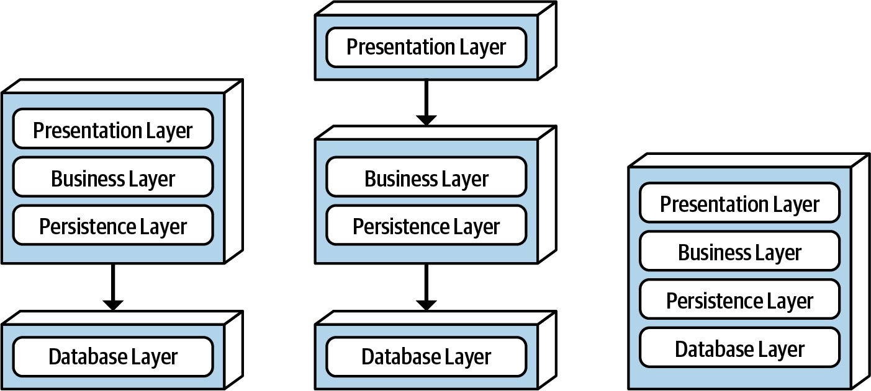
Layered Architecture
Topology
Notes:
Components within the layered architecture style are organized into logical horizontal layers (technical partitioning), with each layer performing a specific role within the application. Although there are no specific restrictions in terms of the number and types of layers, most layered architectures consist of four standard layers: presentation, business, persistence, and database.
The figure illustrates the various topology variants from a physical layering (deployment) perspective.
The first variant combines the presentation, business, and persistence layers into a single deployment unit, with the database layer as a separate external physical database (or filesystem). The second variant physically separates the presentation layer into its own deployment unit. A third variant combines all four standard layers into a single deployment, including the database layer. This variant might be useful for smaller applications.
For example, the presentation layer would be responsible for handling all user interface and browser communication logic, whereas the business layer would be responsible for executing specific business rules associated with the request. The presentation layer doesn’t need to know about how to get customer data. Similarly, the business layer doesn’t need to be concerned about how to format customer data for display; it only needs to get the data from the persistence layer, perform business logic against the data, and pass that information up to the presentation layer.
This separation of concerns concept within the layered architecture style makes it easy to build effective roles and responsibility models within the architecture. This allows developers to leverage their particular technical expertise to focus on the technical aspects of the domain (such as presentation logic or persistence logic). The trade-off of this benefit, however, is a lack of overall agility (the ability to respond quickly to change).

Slide 156
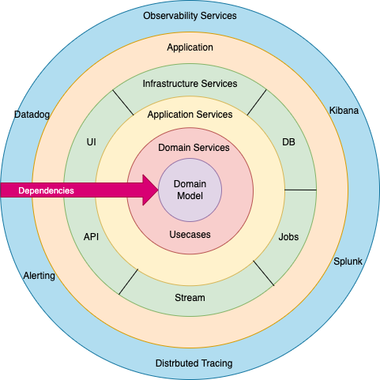
Layered Architecture
Onion Architecture
Notes:
Components are grouped by their technical role in the architecture (technically partitioned).
Any particular business domain is spread throughout all of the layers of the architecture. For example, the domain of “customer” is contained in… the presentation layer, business layer, services layer, and database layer, making it difficult to apply changes to that domain. As a result, a domain-driven design approach does not work as well with the layered architecture style.
But appears DDD-Friendly Layered Architectures (e.g., Onion Architecture) some kind solved this as specifically designed to support DDD principles.
How Onion Architecture Aligns with DDD
Domain-Centric: Places the domain model at the center, surrounded by application and infrastructure layers.
Dependency Inversion: Outer layers depend on inner layers, not vice versa.
Domain doesn't depend on persistence or UI.
Separation of Concerns: Clear boundaries between domain logic and supporting infrastructure.
For example : In the Onion Architecture, the Customer domain concept is centralized in the core, with supporting components arranged around it, aligning well with DDD principles.

Slide 157
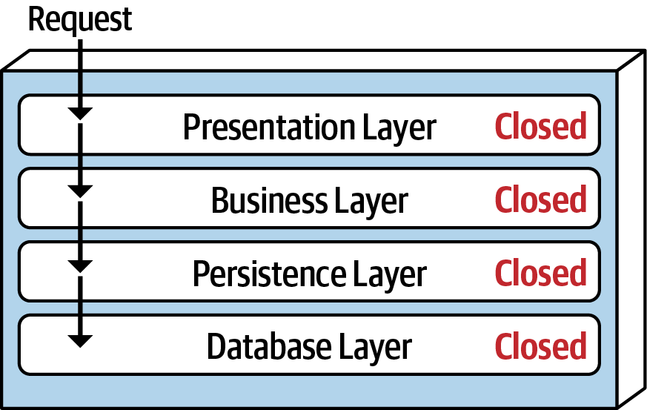
Layered Architecture
Layers of Isolation
Notes:
The layers of isolation concept means that changes made in one layer of the architecture generally don’t impact or affect components in other layers, providing the contracts between those layers remain unchanged.
It also allows any layer in the architecture to be replaced without impacting any other layer (Of course using abstraction).
Layers have to be closed.
A closed layer means that as a request moves top-down from layer to layer in one direction, the request cannot skip any layers, but rather must go through layer by layer.
For example, If the presentation layer can directly access the persistence layer, then changes made to the persistence layer would impact both the business layer and the presentation layer, producing a very tightly coupled application with layer interdependencies between components. This type of architecture then becomes difficult and expensive to change.
For example, you can replace your older MVC presentation layer with React.js without impacting any other layer in the application.

Slide 158
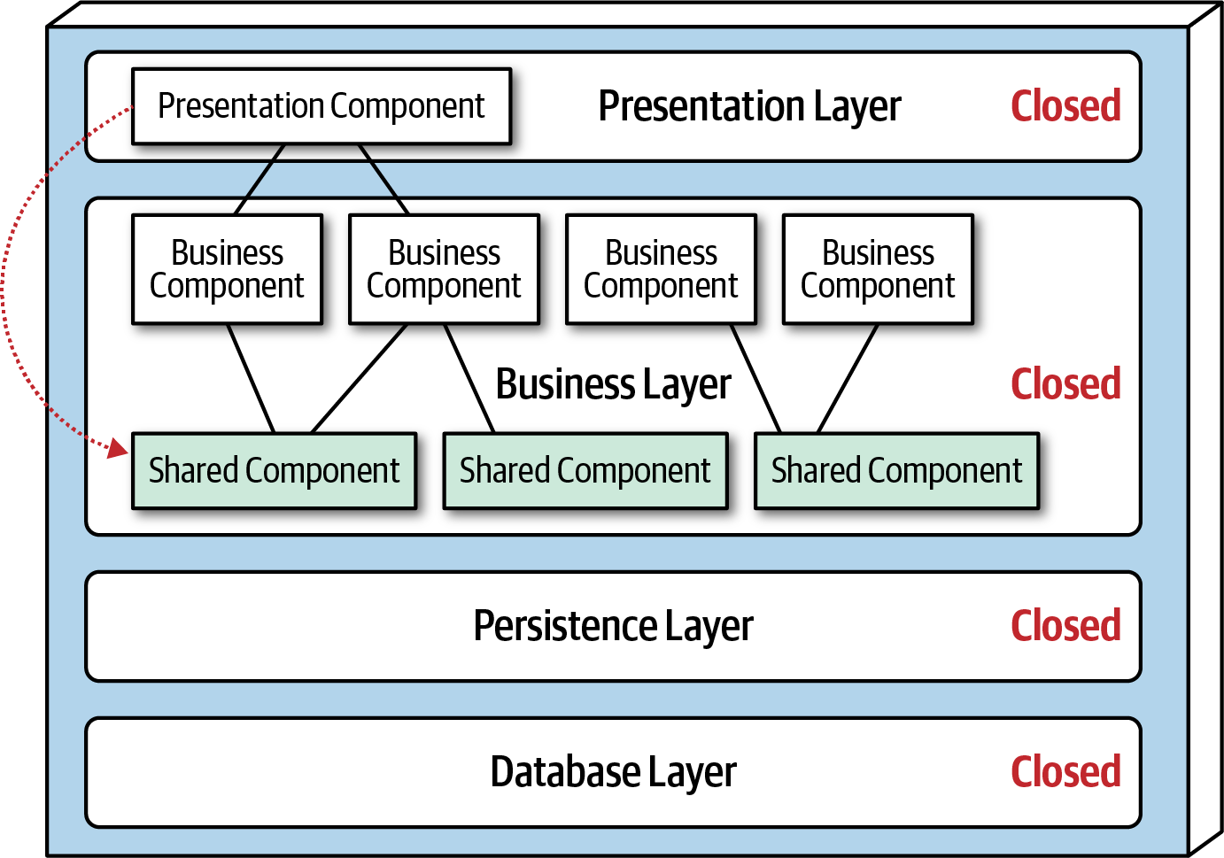
Layered Architecture
Adding Layers
Notes:
While closed layers facilitate layers of isolation, There are times when it makes sense for certain layers to be open. With the dotted line going from a presentation component to a shared business object that the request will access such a shared object while still the request on the presentation layer. This scenario is difficult to govern and control because it violates the closed layer as it should be processed top-down layer by layer (request processed from presentation to business, not vice versa!).

Slide 159
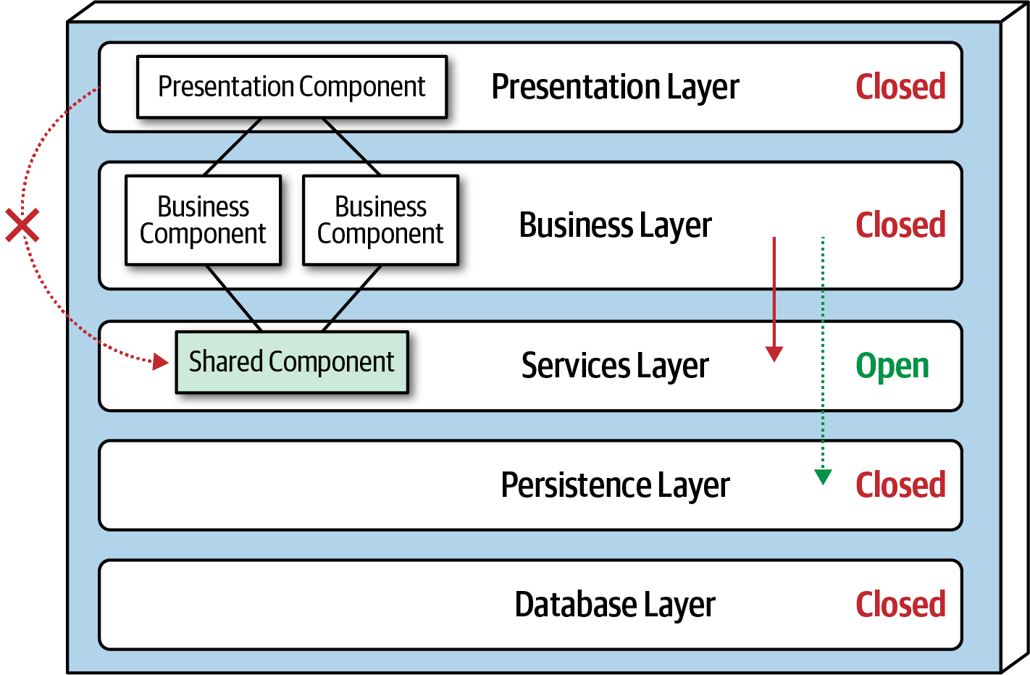
Layered Architecture
Adding Layers
Notes:
One way to architecturally mandate this restriction is to add to the architecture a new services layer containing all of the shared business objects. However, the new services layer must be marked as open; otherwise, the business layer would be forced to go through the services layer to access the persistence layer.
Failure to document or properly communicate which layers in the architecture are open and closed (and why) usually results in tightly coupled and brittle architectures that are very difficult to test, maintain, and deploy.

Slide 160
Layered Architecture
Initially recommended to use this architecture style
Small, simple applications/Websites
Tight budget and time constraints
Still analyzing business requirements
Notes:
The layered architecture style is a good choice for small, simple applications or websites. Particularly as a starting point, for situations with very tight budget and time constraints. Because of the simplicity and familiarity among developers and architects, The layered architecture style is also a good choice when an architect is still analyzing business needs and requirements and is unsure which architecture style would be best.

Slide 161
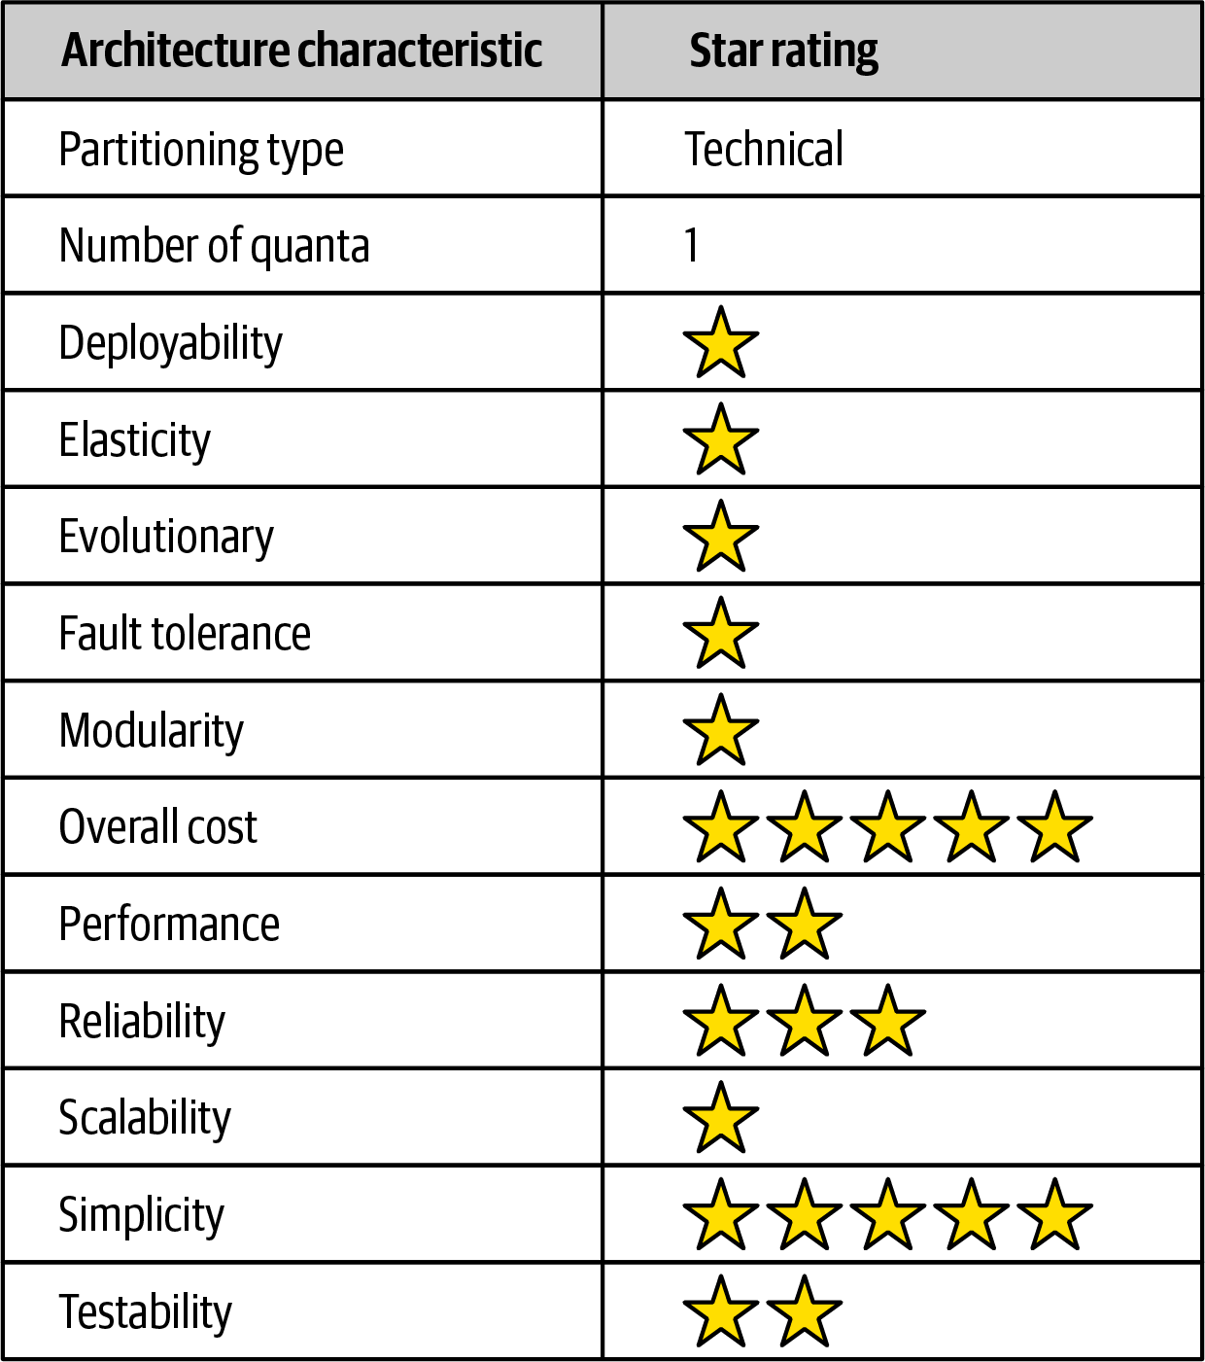
Layered Architecture
Notes:
Overall cost and simplicity (easy to understand, low cost of building and maintain) are the primary strengths of the layered architecture style. Being monolithic in nature.
However, as a cautionary note, these ratings start to quickly diminish as monolithic layered architectures get bigger and consequently more complex.
Both deployability and testability rates are very low for this architecture style. due to the effort to deploy, high risk, and lack of frequent deployments.
A simple three-line code change to a class file requires the entire deployment unit to be redeployed.
The low testability rating also reflects this scenario; with a simple three-line change, most developers are not going to spend hours Re Executing the entire regression test suite.
We gave testability a two-star rating due to the ability to mock or stub components (or even an entire layer) with less effort, which eases the overall testing effort.
Overall reliability rates are medium (three stars), mostly due to the lack of network traffic, bandwidth, and latency found in most distributed architectures and because of the nature of the monolithic deployment in the layered architecture.
Elasticity and scalability rate very low (one star) due to monolithic deployments and the lack of architectural modularity. Although it is possible to scale this monolith, this effort usually requires very complex design techniques such as multithreading, internal messaging, and other parallel processing techniques this architecture isn’t well suited for. However, because the layered architecture is always a single system quantum, applications can only scale to a certain point.
Performance only two stars because of the lack of parallel processing, closed layering, and the sinkhole architecture anti-pattern. Like scalability, performance can be addressed through caching, multithreading, and the like, but it is not a natural characteristic of this architecture style.
Layered architectures don’t support fault tolerance due to monolithic deployments and the lack of architectural modularity. If one small part causes an out-of-memory condition to occur, the entire application unit is impacted and crashes. Furthermore, overall availability is impacted due to the high mean-time-to-recovery (MTTR) usually experienced by most monolithic applications.

Slide 162

Microservices Architecture
Notes:
Microservices is an extremely popular architecture style that has gained significant momentum in recent years. In this chapter, we provide an overview of the important characteristics that set this architecture apart, both topologically and philosophically.
However, if the architect’s goal requires high degrees of decoupling, then they favor duplication over reuse.
Background
Microservices is heavily inspired by the ideas in domain-driven design (DDD), a logical design process for software projects. The concept of bounded context of DDD represents a decoupling style. For example, an application might have a domain called CatalogCheckout, which includes notions such as catalog items, customers, and payment. In a traditional monolithic architecture, developers would build reusable classes and linked databases. Within a bounded context, the internal parts, such as code and data schemas, are coupled together to produce work; but they are never coupled to anything outside the bounded context.
While reuse is beneficial, the negative trade-off of reuse is coupling.
However, if the architect’s goal requires high degrees of decoupling, then they favor duplication over reuse.
The primary goal of microservices is high decoupling, physically modeling the logical notion of bounded context. (From my experience when talk about higher level design ,duplication and decoupling are worther than reuse, and vice versa in low level design you can favor reuse over duplication)

Slide 163

Duplication over Reuse ?
Notes:
The primary goal of microservices is high decoupling, physically modeling the logical notion of bounded context.
(From my experience when talk about higher level design ,duplication and decoupling are worther than reuse, and vice versa in low level design you can favor reuse over duplication) In higher-level design discussions, prioritizing decoupling and allowing some duplication often proves more valuable than reuse. Because loose coupling between services, enhancing maintainability and allowing teams to work more independently. Conversely, at the lower levels of design, favoring reuse over duplication can be more beneficial, as it helps reduce code repetition and promotes consistency within individual services.
Example : A few years ago, Our monolithic application had become unwieldy, making it difficult to implement new features and scale effectively. We decided to transition to a microservices architecture.
During our initial design discussions, we debated how to handle user authentication across different services. Some team members argued for creating a shared library to handle authentication, aiming for code reuse. However, our lead architect pushed for a different approach.
He explained that while a shared library might seem efficient, it would create tight coupling between services. Instead, he proposed allowing each service to implement its own authentication logic. This meant some code duplication, but it allowed each service to evolve independently.
At first, I was skeptical. It felt wrong to duplicate code across services. But as we implemented this approach, I began to see its benefits. When we needed to update authentication for our inventory service to include additional security measures, we could do so without affecting other services. This decoupling made our system more flexible and easier to maintain over time.
However, within each service, we took a different approach. For instance, in our order processing service, we created utility functions for common tasks like data validation and logging. These were reused throughout the service, promoting consistency and reducing duplication at this lower level.

Slide 164
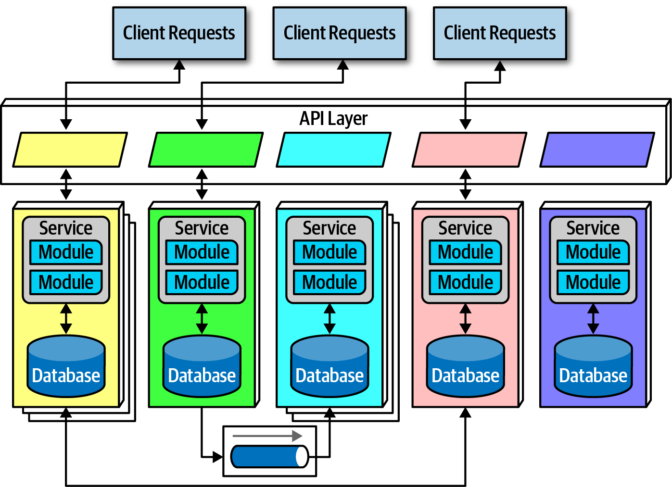
Topology
Notes:
Due to its single-purpose nature, the service size in microservices is much smaller than other distributed architectures. Architects expect each service to include all necessary parts to operate independently, including databases.
Distributed
Microservices form a distributed architecture: each service runs in its own process as virtual machines and containers. Decoupling the services to this degree allows for heavily feature multitenant infrastructure for hosting applications. For example, when using a server to manage multiple running applications, it allows operational reuse of network bandwidth, memory, disk space, and a host of other benefits. However, if all the applications continue to grow, eventually some resource becomes constrained on the shared infrastructure. Another problem concerns improper isolation between shared applications.
Separating each service into its own process solves all the problems brought on by sharing. With cloud resources and container technology, teams can reap the benefits of extreme decoupling, both at the domain and operational level.
Performance is often the negative side effect of the distributed nature of microservices. Network calls take much longer than method calls, and security verification at every endpoint adds additional processing time, requiring architects to think carefully when designing the system.

Slide 165
Bounded Context
Notes:
The driving philosophy of microservices is the notion of bounded context: each service models a domain or workflow. Thus, each service includes everything necessary to operate within the application, including classes, other subcomponents, and database schemas .
Microservices take the concept of a domain-partitioned architecture to the extreme. Microservices is the physical embodiment of the logical concepts in domain-driven design.

Slide 166
Granularity (Service Boundary)
Architects struggle to find the correct granularity for services
Notes:
and often make the mistake of making their services too small (too fine-grained), which requires them to build additional communication links back between the services to do useful work.
The purpose of service boundaries in microservices is to capture a domain or workflow. In some applications, those boundaries might be large for some parts of the system.
Here are some guidelines architects can use to help find the appropriate boundaries:
Purpose
The most obvious boundary, a domain. Ideally, each microservice should be extremely functionally cohesive, contributing one significant behavior of the overall application.
Transactions
Bounded contexts are business workflows, and often the entities that need to cooperate in a transaction show architects a good service boundary.
Choreography and Consolidation
If an architect builds a set of services that offer excellent domain isolation yet require extensive communication to function, the architect may consider bundling these services back into a larger service to avoid the communication overhead.
Remember, Iteration is the only way to ensure good service design. Architects rarely discover the perfect granularity, data dependencies, and communication styles on their first pass.

Slide 167
Data Isolation
avoid all kinds of coupling, including shared schemas and databases.
Notes:
Another requirement of microservices, driven by the bounded context concept, is data isolation. Many other architecture styles use a single database for persistence. However, microservices tries to avoid all kinds of coupling, including shared schemas and databases.
Architects must be wary of the entity trap and not simply model their services to resemble single entities in a database.
Architects can’t create a single source of truth (as used to do in monolith), which is no longer an option when distributing data across the architecture. each service can choose the most appropriate tool, based on price, type of storage, or a host of other factors. Architects can choose a more suitable database (or other dependency) without affecting other teams.

Slide 168
API Layer
Notes:
Most pictures of microservices include an API layer sitting between the consumers of the system, but it is optional. It is common because it offers a good location within the architecture to perform useful tasks, either via indirection as a proxy or a tie into operational facilities such as (Rate Limiting, Authentication and Authorization, Monitoring and Logging, a naming service (essential for service discovery)).
An API layer should not be used as a mediator or orchestration tool to stay true to the underlying philosophy of this architecture: all interesting logic in this architecture should occur inside a bounded context, and putting orchestration or other logic in a mediator violates that rule. Architects typically use mediators in technically partitioned architectures, whereas microservices is firmly domain partitioned.

Slide 169
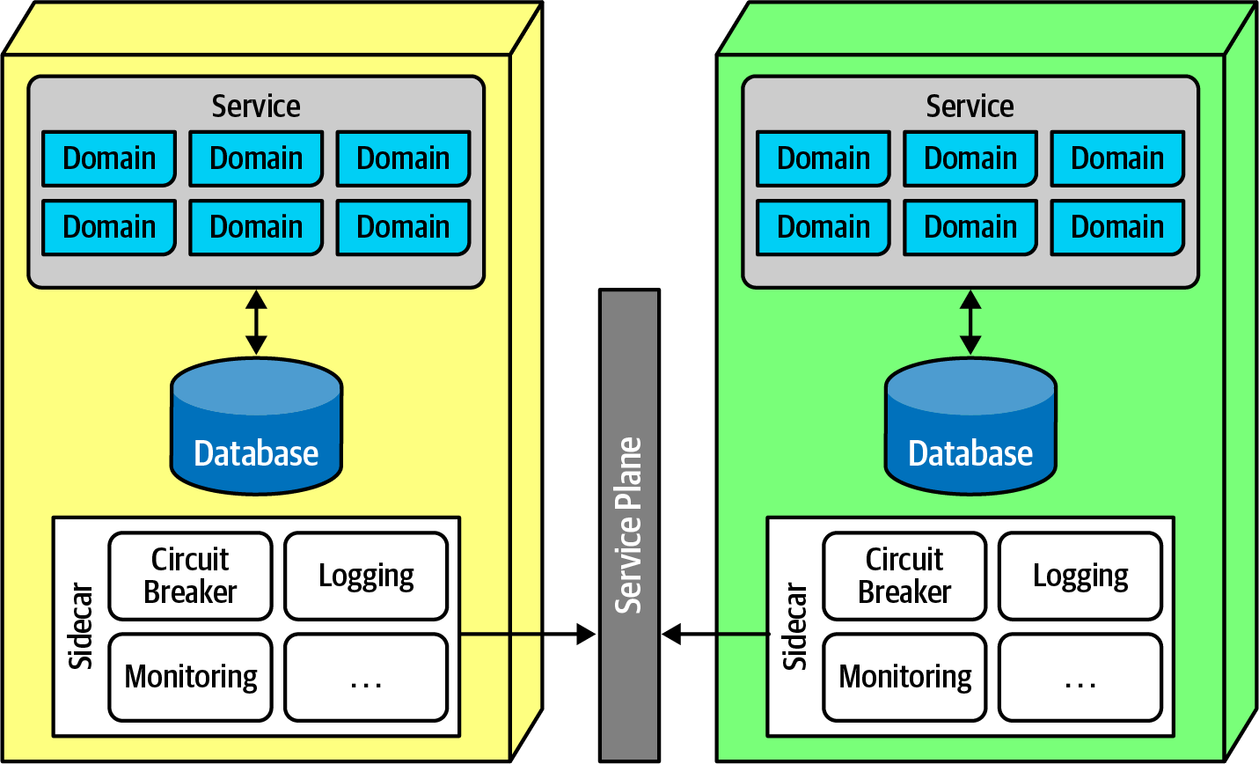


API Layer
SideCar Pattern
Notes:
Given that microservices prefer duplication to coupling, how do architects handle the parts that really do benefit from coupling, such as operational concerns like monitoring, logging, and circuit breakers? In microservices, architects try to split these two concerns.
Once microservices are created, teams realize that each has common elements (cross cutting concerns) that benefit from similarity. For example, if an organization allows each service team to implement monitoring themselves, how can they ensure that each team does so and handle monitoring tool upgrades too?
The sidecar pattern offers a solution to this problem.
The sidecar component handles all the operational concerns that teams benefit from coupling together. Thus, (for example) when it comes time to upgrade the monitoring tool, the shared infrastructure team can update the sidecar.
Once teams know that each service includes a common sidecar wire into the service plane, they can build a service mesh, allowing unified control across the architecture and all microservices.
The service mesh forms a console that allows teams to globally control operational coupling, such as monitoring levels, logging, and other cross-cutting operational concerns.

Slide 170
API Gateway
Problem : How do the clients of a Microservices-based application access the individual services?
Notes:
Microservices typically provide fine-grained APIs, which means that clients need to interact with multiple services.
Different clients need different data. For example, the desktop browser version of a product details page desktop is typically more elaborate then the mobile version.
Network performance is different for different types of clients. For example, a mobile network is typically much slower and has much higher latency than a non-mobile network.
The server-side web application can make multiple requests to backend services without impacting the user experience whereas a mobile client can only make a few.
The number of service instances and their locations (host+port) changes dynamically

Slide 171


Notes:
Implement an API gateway. It is a server that acts as a reverse proxy, receiving incoming requests from clients and forwarding them to the appropriate microservices. It serves as a central entry point for external clients to access the microservices within a system. API gateways offer functionalities like request routing, transformation, authentication, rate limiting, and caching, making them essential for managing and exposing APIs to external users.
Variation : backend for frontends
Rather than provide a one-size-fits-all style API, the API gateway can expose a different API for each client.

Slide 172
Benefits
Resulting Context
Simplifies the client
Reduces requests/roundtrips
Optimizing system performance
Public web-friendly API protocol
Centralized security
Analytics and monitoring capabilities
Drawbacks
Increased complexity
Increased response
Notes:
Resulting Context
Using an API gateway has the following benefits:
Simplifies the client by moving logic for calling multiple services from the client to API gateway.
Provides the optimal API for each client.
Reduces the number of requests/roundtrips. For example, the API gateway enables clients to retrieve data from multiple services with a single round-trip.
API gateways excel in optimizing system performance with efficient request routing and load distribution to backend microservices. Additionally, it employs caching mechanisms that not only improve response times but also alleviate the load on services, contributing to a smoother user experience.
Translates from a “standard” public web-friendly API protocol to whatever protocols are used internally.
It provides centralized security enforcement by implementing robust authentication and authorization mechanisms.
It provides analytics and monitoring capabilities, allowing you to closely track API usage and performance metrics, essential for maintaining a healthy microservices ecosystem.
The API gateway pattern has some drawbacks:
Increased complexity - the API gateway is yet another moving part that must be developed, deployed and managed
Increased response time due to the additional network hop through the API gateway - however, for most applications the cost of an extra roundtrip is insignificant.
While Service Mesh and API gateway are distinct components serving different purposes, they do share some important similarities in their roles within microservices architectures.
Architect and Developers must be aware that they have to update the API gateway every time a microservice is added or removed because API gateway needs to be aware of the available services and their endpoints.
Service mesh typically offers network management scalability and flexibility that exceeds the capabilities of traditional API gateways.

Slide 173
Microservices Communication
Notes:
architects and developers struggle with appropriate granularity of each service, which affects both data isolation and communication. Finding the correct communication style helps teams keep services decoupled.
Fundamentally, architects must decide on synchronous or asynchronous communication. Microservices architectures typically utilize protocol-aware heterogeneous interoperability.
Protocol-aware Services must know (or discover) which protocol to use to call other services.
Heterogeneous: Because microservices is a distributed architecture, each service may be written in a different technology stack. Heterogeneous suggests that microservices fully support different environments.

Slide 174
Communication
ENFORCED HETEROGENEITY
Notes:
In some organization, they had a fast-moving problem domain, the architect wanted to ensure that none of the development teams accidentally created coupling points between each other. He mandated each development team to use a different technology stack. If one team was using Java and the other was using .NET, it was impossible to accidentally share classes!
This approach is the polar opposite of most enterprise governance policies, which insist on standardizing on a single technology stack.
The goal in the microservices world is to choose the correct scale technology for the narrow scope of the problem. This concept leverages the highly decoupled nature of microservices.
For asynchronous communication, architects often use events and messages, thus internally utilizing an event-driven architecture.
The broker and mediator patterns manifest in microservices as choreography and orchestration.

Slide 175


Communication
Choreography
Notes:
Choreography utilizes the same communication style as a broker event-driven architecture. In other words, no central coordinator exists in this architecture (Decentralized Transaction Management).
Event driven Idea is services react autonomously to events from other services
Thus, architects find it natural to implement decoupled events between services (Choreography).
The user requests details about a user’s wish list.
Because microservices architectures don’t include a global mediator like other service-oriented architectures,
If an architect needs to coordinate across several services,
they can create their own localized mediator service like in this next pic

Slide 176


Communication
Orchestration
Notes:
However, common problems like error handling and coordination become more complex in choreographed environments.
Consider this pic example … The first service called must coordinate across a wide variety of other services, basically acting as a mediator in addition to its other domain responsibilities. This pattern is called the front controller pattern.
So alternatively, an architect may choose to use
orchestration service for complex business processes, illustrated in the figure.
The architect builds a mediator (Centralized Transaction Management) to handle the complexity and coordination required for the business workflow. While this creates coupling between these services, it allows the architect to focus coordination into a single service.

Slide 177


Communication
Transactions and Sagas
Notes:
Architects often encounter the problem of how to do transactional coordination across services. Atomicity that was trivial in monolithic applications becomes a problem in distributed ones.
Building transactions across service boundaries ( whatever orchestration or choreography or others ) violates the core decoupling principle of the microservices architecture
also worst kind of dynamic connascence
The best advice for architects who want to do transactions across services is:
don’t! – Fix the granularity components instead.
Exceptions always exist. For example, two completely different services in architecture characteristics and distinct service boundaries, yet still need transactional coordination. In those situations, patterns exist to handle transaction orchestration, with serious trade-offs.
the saga pattern :
A service acts as a mediator (Centralized or Decentralized Transaction Management) across multiple service calls and coordinates the transaction. The mediator calls each part of the transaction, records success or failure, and coordinates results.
If everything goes as planned, all the values in the services and their contained databases update synchronously.
In an error condition, the mediator must ensure that no part of the transaction succeeds if one part fails.
Consider the figure.
If the first part of the transaction succeeds, yet the second part fails, the mediator must send a request to all the parts of the transaction that were successful and tell them to undo the previous request. This style is called a compensating transaction framework. Developers implement this pattern by usually having each request from the mediator enter a pending state until overall success.
However, this design becomes complex if many asynchronous requests must exist and also creates a lot of coordination traffic at the network level.
The best advice for architects is to use the saga pattern sparingly (only when much needed).

Slide 178

Notes:
The high points of this architecture are scalability, elasticity, and evolutionary. Because the architecture relies heavily on automation and intelligent integration with operations (devops). Because the architecture favors high decoupling at an incremental level, it supports the modern business practice of evolutionary change. By building an architecture that has extremely small deployment units that are highly decoupled, architects have a structure that can support a faster rate of change.
Performance is often an issue in microservices as it has high performance overhead, and they must invoke security checks to verify identity and access for each endpoint. Many patterns exist to increase performance, including intelligent data caching and replication.
Performance is another reason that microservices often use choreography (decentralized event driven) rather than orchestration, as less coupling allows for faster communication and fewer bottlenecks.

Slide 179
Fundamentals of Software Architecture Part 3
From developer to architect: Key concepts for the transition

Slide 180
CONTENTS
Here’s what you’ll learn:
Microservice Decomposition: A Case Study of a Large Industrial Software Migration in the Automotive Industry
Choosing the Appropriate Architecture Style
Diagramming and Presenting Architecture
Developing an Architect Career Path

Slide 182
01
02
03
Clarity on Core Principles
Best Practices for Long-term Design
Deep Dive into Software Architecture
Setting Expectations
04
05
Real-world Examples & Case Studies
Developing Architect Career Path

Slide 183
01
02
BUSINESS OVERVIEW
MARKET ANALYSIS
TABLE OF CONTENTS
03
04
MANAGEMENT PLAN
OPERATING PLAN
You can describe the topic of the section here
You can describe the topic of the section here
You can describe the topic of the section here
You can describe the topic of the section here

